Slide 1
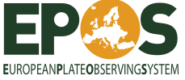
EPOS - WG7 Status
E-infrastructures and virtual community
Keith Jeffery, Alberto Michelini, Jean-Pierre Vilotte
Utrecht, November 10, 2011
Modifications: Alessandro Spinuso, Torild van Eck
(figures and seismology implementations)

Slide 2
EPOS main Goal: e-Science !
How to build an e-infrastructure to do e-science ?
  make the different (geo-)disciplines talk to one-another
  Let them have maximum freedom to organize themselves as they wish but
  Direct the disciplines to adopt a common “glue”
Notes:
We should get feedback from Joern Lauterjung to this regard since we provided the basic template for the survey of the infrastructures.

Slide 3
Steps to achieve EPOS e-Infrastructure
(decisions agreed at the 2011 WG7 meeting at EGU)
Define / Agree requirements of end-user
Notes:
We should get feedback from Joern Lauterjung to this regard since we provided the basic template for the survey of the infrastructures.

Slide 4
Steps to achieve EPOS e-Infrastructure
(decisions agreed at the 2011 WG7 meeting at EGU)
Define / Agree requirements of end-user (document dynamically)
Survey available data/information sources
Notes:
We should get feedback from Joern Lauterjung to this regard since we provided the basic template for the survey of the infrastructures.

Slide 5
Steps to achieve EPOS e-Infrastructure
(decisions agreed at the 2011 WG7 meeting at EGU)
Define / Agree requirements of end-user (document dynamically)
Survey available data/information sources (document dynamically)
Define schema mappings, convertors for interoperation
Notes:
We should get feedback from Joern Lauterjung to this regard since we provided the basic template for the survey of the infrastructures.

Slide 6
Steps to achieve EPOS e-Infrastructure
(from EPOS community perspective) → Dynamical documents
(decisions agreed at the 2011 WG7 meeting at EGU)
Define / Agree requirements of end-user
  Including expected future requirements
    e.g., 20 most common queries (?) (needs poll in the future)
Survey available data/information sources
  Instrumentation
  Repositories / databases / file systems
  Data, documents, metadata, contextual data
  Conditions of use – QoS, SLA (➔link to governance)
Define schema mappings, convertors for interoperation
  Canonical interoperation standard?
    Note CERIF, INSPIRE, …
Notes:
What is meant for document dynamically ?

Slide 7
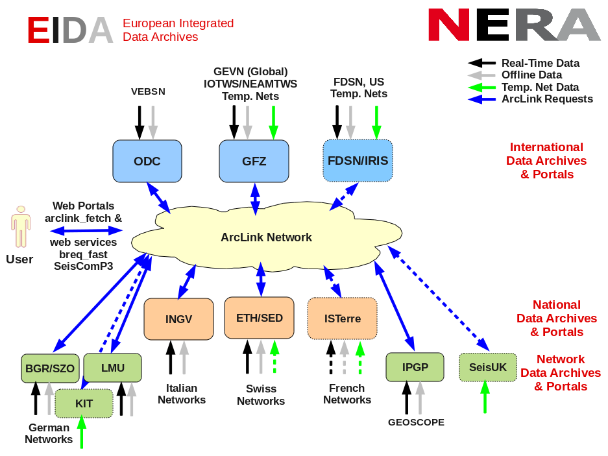
Example existing distributed archive (design GFZ)
(NOA)

Slide 8
Steps to achieve EPOS e-Infrastructure
(from an ICT perspective) → dynamical documents
Survey available computing and computation resources
  Data servers
  HPC
  Conditions of use – QoS, SLA (➔link to governance)
Define access and utilisation of ICT
  User identification, authentication, authorisation, accounting (security, privacy)
  Available services
  Conditions of use – QoS, SLA (➔link to governance)
Design first-cut ICT architecture
  GEANT network
  GRIDs (EGI) middleware
  Web services software
  Web portal(s) user interface
Notes:
See notes to previous slide. With regard to the second bullet, VERCE and EUDAT (and probably ENVRI) are addressing the issue. For the third bullet, I think that there is not yet a clear connection with regardto GEANT and EGI, WS are maturing, Web Portals need to be developed further.

Slide 9
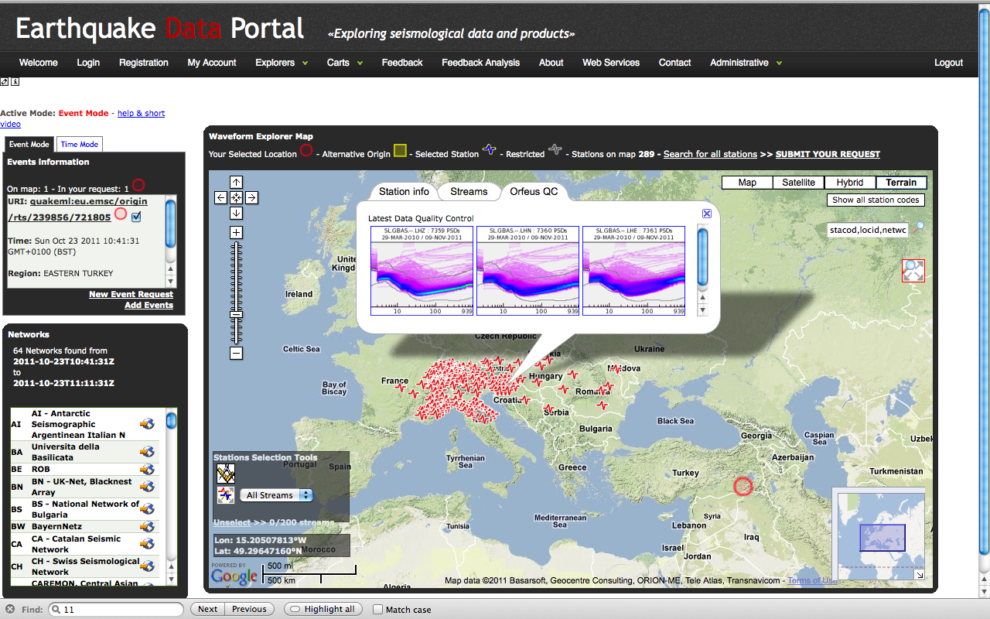
EPOS (seismology) e-Infrastructure: first steps
ORFEUS-EMSC joint operation: NERIES project → NERA project
Seismic data portal www.seismicportal.eu

Slide 10
In summary, the way to proceed…
WG7 moves along two distinct but complementary tracks
  Database existing research infrastructures (RI)
  Design EPOS e-Research Infrastructure

Slide 11
1. DB of the existing RI
Track 1:
general, comprising all existing individual research infrastructures:
Gather the information regarding the “digital organization” of the individual RI (e.g., types of Digital Objects – DO - amount of generated data, storage requirements, accessibility, user identification, ....)
Design and organize within a DB all the information relative to the RIs.
Accomplishment of the two points above will allow EPOS to have a clear idea of what is the existing and how this is distributed across Europe. This information is essential in order to provide a perspective of the existing communities within EPOS. Important deliverables of this first track will be graphs and maps representing the distribution of the resources and the current national investments.
Note that this part is essential for disseminating the work done behind the scenes by EPOS during the PP.

Slide 12
2. Design of the EPOS e-RI
Track 2: build on, and improve, existing developments:
Exploit what is built within the seismological community – the most advanced in terms of ICT solutions
… but copy, good practise, from other physically based sciences like astronomy, … (!)
… and environmental science, materials science, biomedical science …

Slide 13
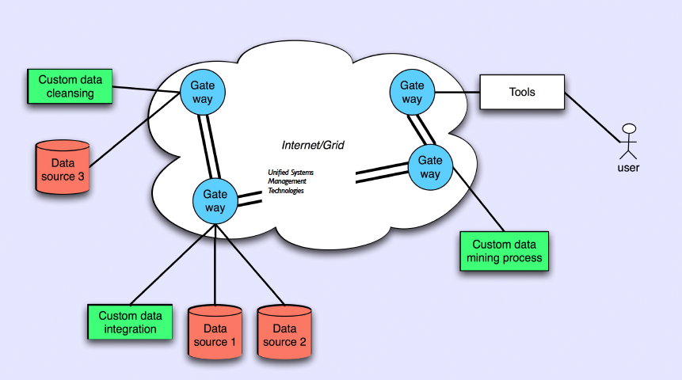
Design of an EPOS (seismology) e-RI
Admire project (- 2011) → VERCE project (2011 – 2015)→ EPOS multidisciplinary

Slide 14
2. Design of the EPOS e-RI (2)
Definition of Virtual observatory (VO)
A collection of interoperating data archives and software tools which utilize the internet to form a scientific research environment in which astronomical research programs can be conducted.
In much the same way as a real observatory consists of telescopes, each with a collection of unique astronomical instruments, the VO consists of a collection of data centres each with unique collections of astronomical data, software systems and processing capabilities.
The main goal is to allow transparent and distributed access to data available worldwide. This allows scientists to discover, access, analyze, and combine nature and lab data from heterogeneous data collections in a user-friendly manner

Slide 15
User perspective
EPOS Virtual Observatory should offer !
In general:
something that cannot be offered by our own lap- or desktops,
among others:
Data (many!)
Well tested analysis software that uses the data
Space for the analysis (workspace)
Computational power
interaction with other users to share and merge results, i.e. team work
digital object preservation, curation, access and provenance
....

Slide 16
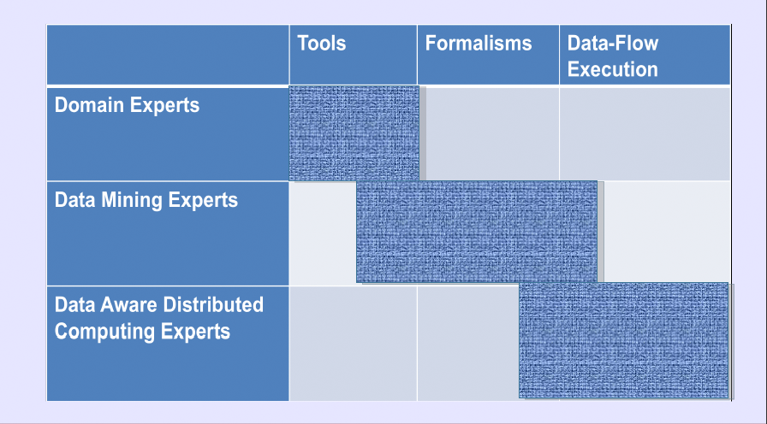
The challenge to merge different expertise
Communication between scientists, data experts, computing experts

Slide 17
EPOS architecture
A portal for user access with querying and browsing capability, also with access (via the catalogue(s) and GRID technology) to datacentres providing the data download, analysis, display, simulation capability;
One centralised or several mirrored catalogues each with contextual metadata and exposing discovery metadata linked intimately with the portal;
Many distributed datacentres with datasets, software and services described by detailed metadata which is referenced in context from the catalogue(s);

Slide 18
EPOS architecture:
The Glue
Metadata are the Glue:
The metadata should comply withinternational standards to allow homogeneous access over heterogeneous data, software and services
  International de jure (ISO/INSPIRE),
  International broad consensus (e.g. internet standard, W3C)
  Encoding standard (UNICODE, UTF)
  ….

Slide 19
EPOS architecture:
The Glue
The metadata must have a formal syntax and declared semantics so that
  machine-understandable,
  machine readable / duplicable,

Slide 20
EPOS architecture:
The Glue
The metadata must be fit for purpose for the following functions related to a digital object:
  discovery,
  reading,
  ingesting,
  combining,
  processing,
  outputting as a modified version,
  citing,
  preserving,
  (all related to organizations, projects, persons, other datasets, publications etc and located in space and time).

Slide 21
EPOS architecture
The Rationale and Advantage
The metadata stack and architecture proposed gives EPOS
the following major advantages:
It can be superimposed on existing datacentre datasets, software and services;
It can cover all the types of data, software and services known within EPOS;
The architecture minimises the impact on existing datacentres;
  The datacentres have only to register their data, software and services with metadata in the catalogue(s)
The architecture provides homogeneous access for an end-user to heterogeneous data, software and services;
The architecture can interoperate with others if – for example – North America or Asia chooses a different metadata standard;

Slide 22
Seismology Research Infrastructure related projects
EPOS (seismology) IT and application developments

Slide 23
EPOS e-infrastructure developments
Seismology → multidiscilinary
NERA – Research infrastructures seismologists and earthquake engineers
Integration distributed data archives (EIDA continuation)
web services (+ portlets) standardization globally (FDSN)
products (implementation gateway)
VERCE – Virtual Research Observatory (seismology)
Testbed for implementing and developing HTC and HPC applications.
Testbed e-infrastructure coupling data-archives ← →computational resources
EUDAT – Integrating computational resources and data archives (general)
core services for federated distributed archives
user/ groups workspaces and user interaction
digital object preservation, curation and access (vi. above)
ENVRI – interoperability and standardization environmental sciences
COOPEUS – EU–US coordination EPOS – EarthScope (IRIS, UNAVCO) developments

Slide 24
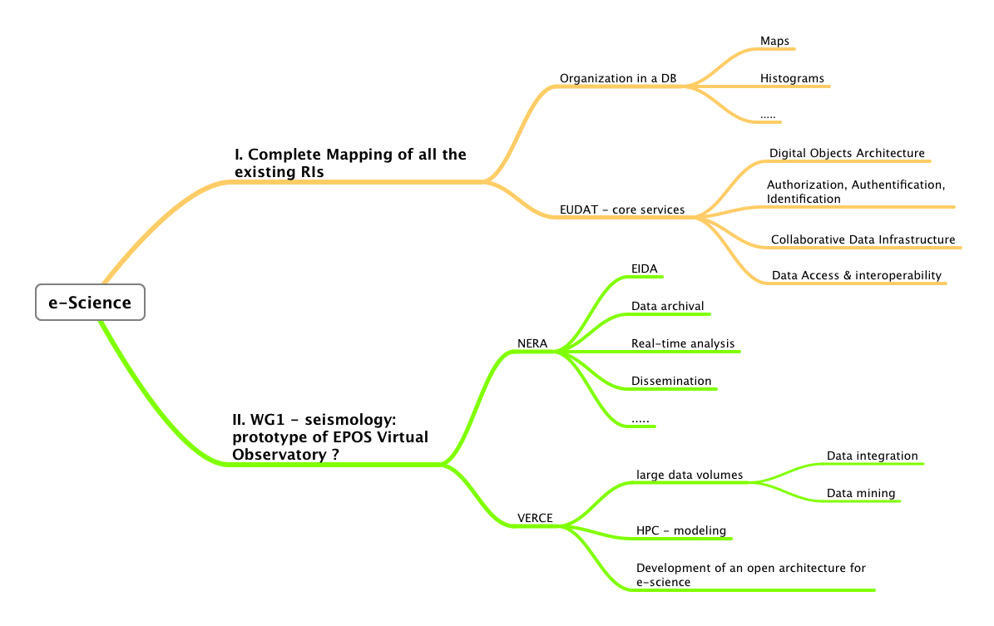
EPOS PP e-Science: a coordination challenge
Optimal coordination developments in the different projects

Slide 25
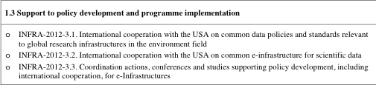
EC – US Cooperation
3.1 – COOPEUS (ORFEUS, INGV)
3.2 – iCordi (CINECA, EPCC)
3.3 – COBII (INGV)
Link to EartCube (http://www.nsf.gov/geo/earthcube/index.jsp)

Slide 26
Thank you

Slide 27
Q1- Interactions with existing European platforms
Ocean and seafloor sciences
EMSO - ESONET
Outreach
Communityinteraction
Engineering seismology
EFAST - SERIES
Technical developments
VERCE
NERA
ORFEUS
EMSC
FDSN
Seismology: research and data infrastructure
Earthquakes, Volcanoes, Earth dynamics, Tectonics
EPOS Preparatory Phase project
Earth Observation
GEOSS, ESA
Standards
Technical developments
Environmental ESFRI initiatives
EUDAT, ENVRI proposals
EGI/HPC
INSPIRE
E-science ecosystems: research and infrastructure
Notes:
Q1: How will you interact with existing platforms in the field, such as EMSO and EFAST?
The European Multidisciplinary Seafloor Observatory (EMSO) project is coordinated by INGV and there is close collaboration with EPOS. EMSO is a multidisciplinary project with a wide variety of sensors and physical measurements. The data problematic bares similarities with that of the volcano observatories in EPOS. VERCE will be therefore be in contact with EMSO through INGV and EPOS. A first action will be related with the seismology observations. Discussions between EMSO and EPOS are well advanced. The seismology data of EMSO should be hosted in the EPOS/Seismology data infrastructure. EMSO and EPOS should converge toward a similar data access policy for seismology data. Within this framework, VERCE will interact with EMSO and include the EMSO seismology data access in a first step. Integration of other data will follow the evolution within EPOS, and between EPOS and EMSO. This is in close relation with the Volcano observatories.
EFAST is a European Design Study for Advanced Seismic Testing aiming to create a research infrastructure for shaking table facilities. EFAST is closely linked to Seismic Engineering Research Infrastructures For European Synergies (SERIES) project, collaborating with NERA. Discussions are in progress for developing coordinated portals. VERCE will follow this evolution and possibly interact at some point through SERIES and NERA. The data policy of the Seismic engineering community is more diverse than that of the seismology community. The experimental seismic data of EFAST will probably remain in the facility sites.
VERCE will develop collaborations with ESA under the coordination of EPOS.

Slide 28
EPOS architecture:
The Proposed Metadata Stack
A simple ‘flat’ metadata standard for discovery; (flat metadata means it is a single record with attributes rather than a group of linked records each with attributes and with relationships between the records)
A structured (linked entity) standard for context (relating the dataset to provenance, purpose, environment in which generated etc);
Detailed metadata standards for each kind of data to be co-processed;

Slide 30
EUDAT: EPOS Digital Object Architecture for seismological data
For example, the main seismic data format is called SEED (Standard for the Exchange of Earthquake Data), which is organized in this way:
Control headers (formatted in ASCII) – called dataless (metadata)
information about the volume, the station-channels, and the data
Time series (binary, unformatted) – called mini-seed (data)
seismic waveform data
And the protocol to exchange such format is called ArcLink, a TCP based distributed data archive access protocol, which allows to perform data request based on time windows.
The Handle Generator has not been implemented yet, but it should be able to manage URIs (IETF rfc 3986), which are used as PIDs.
deposits
via RAP2
Person who manually
creates the dataless
Dataless
Repository (DB)
URI generator
requests triggered
by user requests
hands-over
requests
metadata
requests
Seismic station
Depositor 3
originator
Depositor 2
Mini-seed
Repository
(filesystem
based)
user
hands-over
deposits
via ArcLink
deposits
via ArcLink
Full-seed
(dataless+mini-seed)
receives
disseminations
via ArcLink
work
ownership
replicates
stores
data (mutable DOs)
(both continuous
and discrete)
maintains
replicates
repository C
registered DO
- data
- metadata
(Key-MD)
PID
property record
rights
type
(from central registry)
ROR flag
mutable flag
transaction record
repository D
Part related to mutable DO
Part related to registered DO

Slide 31
EPOS architecture:
The Glue
A key requirement of any metadata stack is interoperability with other metadata standards to allow homogeneous access over heterogeneous data, software and services.
The proposed stack is capable of interoperating with at least
  DC (Dublin Core, see http://dublincore.org/), MARC, MODS, e-GMS, US International Dataset Standard, INSPIRE, CSMD all of which are more-or-less relevant to research (scientific) datasets and associated metadata.

