Slide 1
HPC FOR INDUSTRY
Alessandro Chiarini
HPC Methods for Engineering, 18th June 2015
Photo by hummyhummy - Creative Commons Attribution License http://www.flickr.com/photos/10661167@N02
Created with Haiku Deck

Slide 2
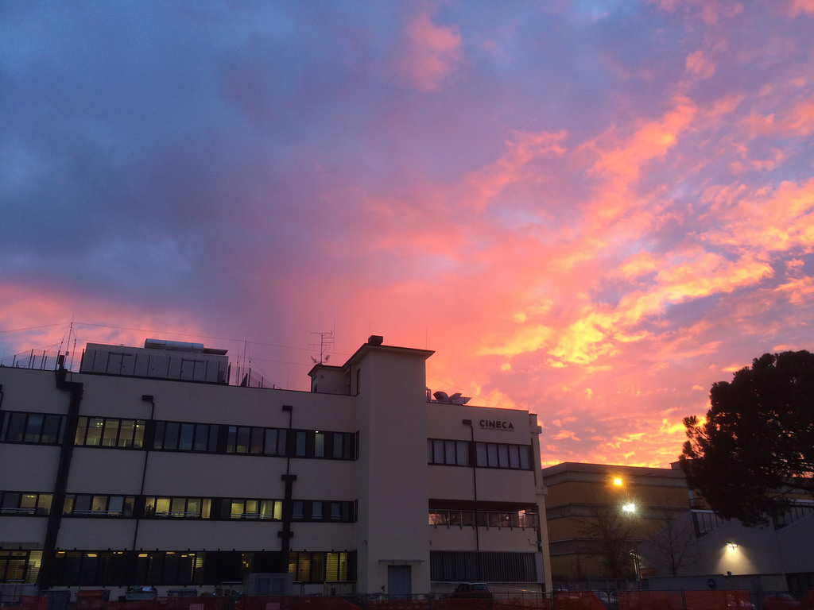
CINECA IN FIGURES
Founded in 1969
72 Universities + 4 Public institutions
3 sites
2 controlled companies (Kion, SCS)
> 900 employees

Slide 3
CINECA - SCAI
1 Tier 0 system(Fermi) e 3 Tier 1 (Galileo, Eurora, Pico)
Best placement in Top500: #7 (Fermi, 2012)
Best placement in GreenTop500: #1 (Eurora, 2013)
Total storage capacity: >15PB
HPC services to support public research
International: PRACE
Italian: ISCRA
Technological transfer towards industry
Photo by Argonne National Laboratory - Creative Commons Attribution-NonCommercial-ShareAlike License http://www.flickr.com/photos/35734278@N05
Created with Haiku Deck
Notes:
<number>

Slide 4
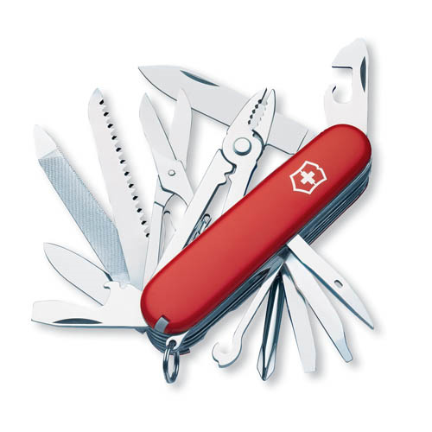
SCS SUPERCOMPUTING SOLUTIONS
Funded in 2003
HPC services marketing and sales
Consultancy services (CAE, HPDA)
Development of integrated solutions (HPC+CAE+HPDA)
Photo by tobi_digital - Creative Commons Attribution-NonCommercial License http://www.flickr.com/photos/37475356@N00
Created with Haiku Deck
Notes:
HPDA = High performance data analytcs = big data
<number>

Slide 5
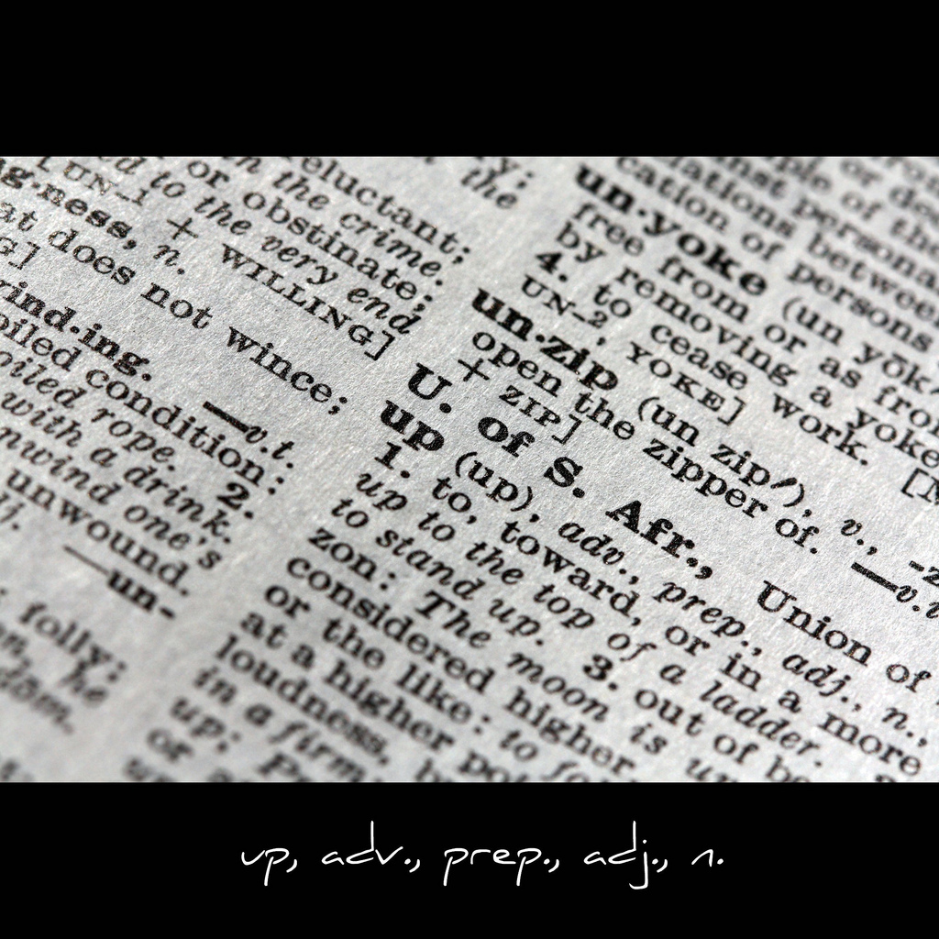
HIGH PERFORMANCE COMPUTING
“Centralize a computing capacity in a single system to provide much higher performance than those of a workstation or a desktop computer. This capability is used to solve problems in chemistry, physics, engineering or finance.” (source: HPC Inside)
Photo by John-Morgan - Creative Commons Attribution License http://www.flickr.com/photos/24742305@N00
Created with Haiku Deck

Slide 6
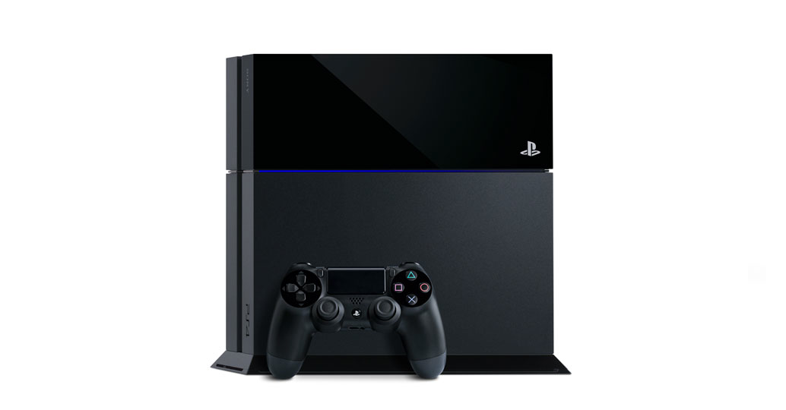
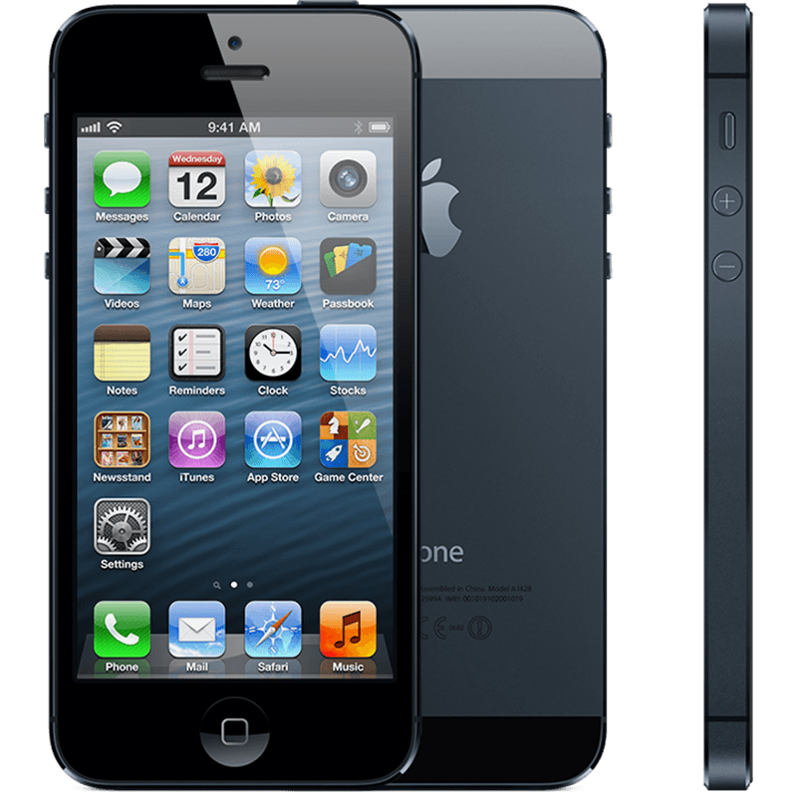
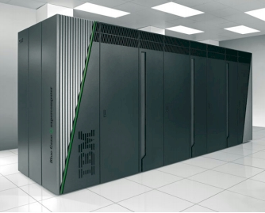
EVOLUTION
FERMI

Slide 7
APPLICATIONS
Heavy Industries
Finance/Insurance
Naval
Oil & Gas
Aerospace
Automotive
Light Industries
Pharma
Medical Devices
Supply Chain

Slide 8
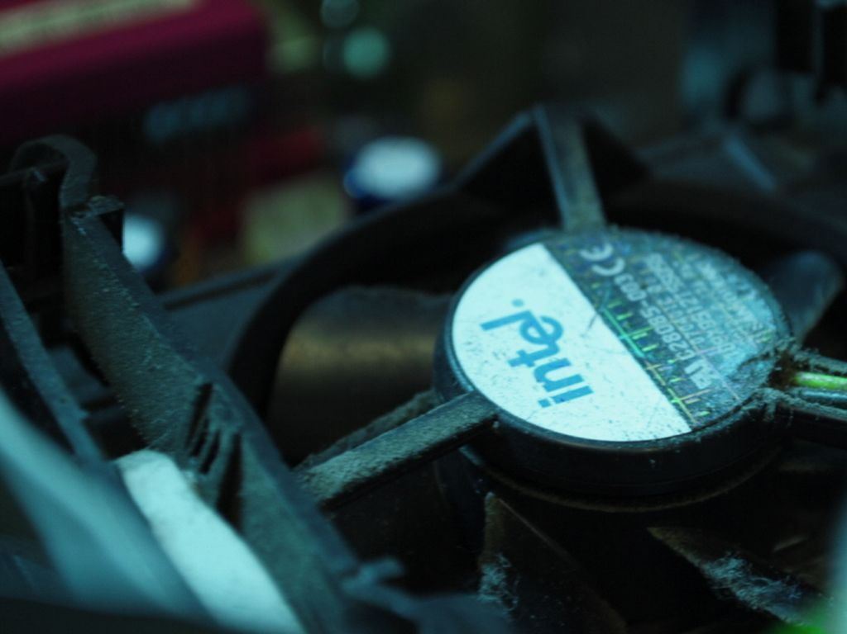
THE HPC IN THE PRODUCT CYCLE
Photo by Mylla - Creative Commons Attribution-NonCommercial-ShareAlike License http://www.flickr.com/photos/83969782@N00
Created with Haiku Deck
Notes:
<number>

Slide 9
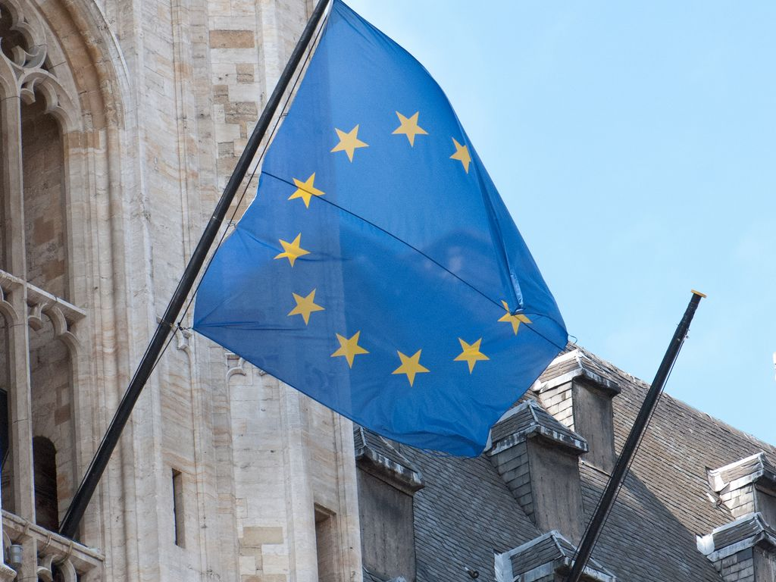
EU PRIORITIES
EC increased its HPC investment to 1.2B€
To reach 1ExaFlops within 2020
Make more relevant the EU HPC ecosystem
Make more fair the HPC market for EU operators
Photo by quinet - Creative Commons Attribution License http://www.flickr.com/photos/91994044@N00
Created with Haiku Deck

Slide 10
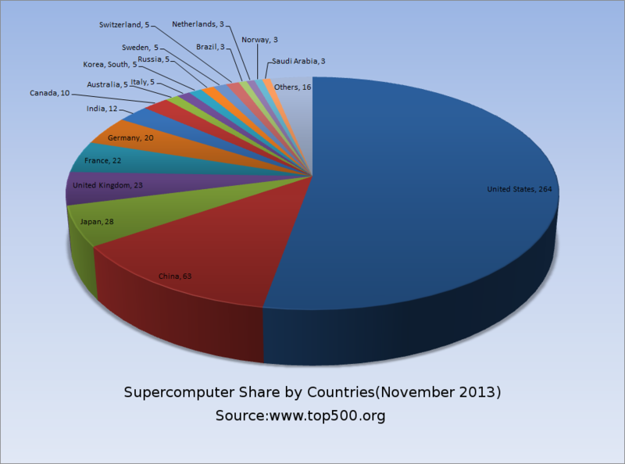
THE EU CHALLENGE
Photo by quinet - Creative Commons Attribution License http://www.flickr.com/photos/91994044@N00
Created with Haiku Deck

Slide 11
EC ACTIONS
Strengthen e-infrastructure programs (PRACE)
Creating PPP to promote the adoption of HPC technologies (ETP4HPC, FoF)
To develop centre of excellence for application domains
To promote specific actions to improve applications scalability to exascale class.
To promote specific actions in order to improve productive technologies (aka power consumption, e.g. DEEP)
To promote actions to standardize the access services (Cloud, PaaS, IaaS, HPCaaS -> Fortissimo).
Photo by quinet - Creative Commons Attribution License http://www.flickr.com/photos/91994044@N00
Created with Haiku Deck

Slide 12
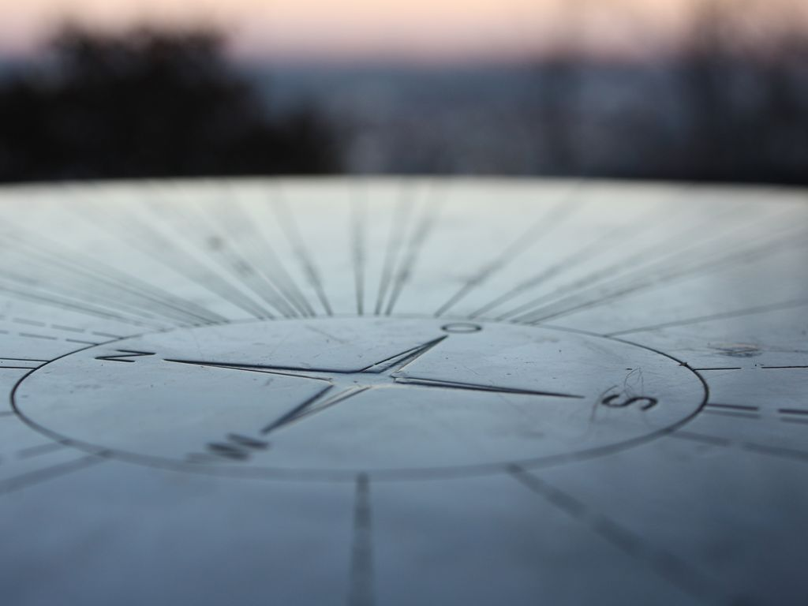
THE HPC MARKET
HPC market is foreseen in constant growth for the next three years (ave. 7,6%, IDC data)
China, US, Korea, Russia leaders claimed that HPC is the key to competitiveness of their industry.
Among segments, storage will grow the most.
Big data, particularly HPDA will be trending.
Photo by marfis75 - Creative Commons Attribution-ShareAlike License http://www.flickr.com/photos/45409431@N00
Created with Haiku Deck

Slide 13
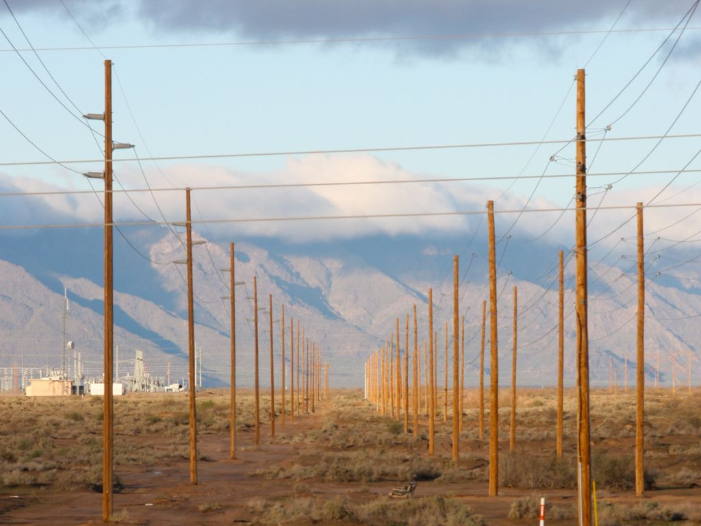
THE CHALLENGES-1
To keep low operational costs (that can reach 20% of the total cost of a HPC system, 20M€/y)
Cooling
Partnership CINECA-Eurotech
Sustainable, eco-friendly datacentre
Photo by kevin dooley - Creative Commons Attribution License http://www.flickr.com/photos/12836528@N00
Created with Haiku Deck

Slide 14
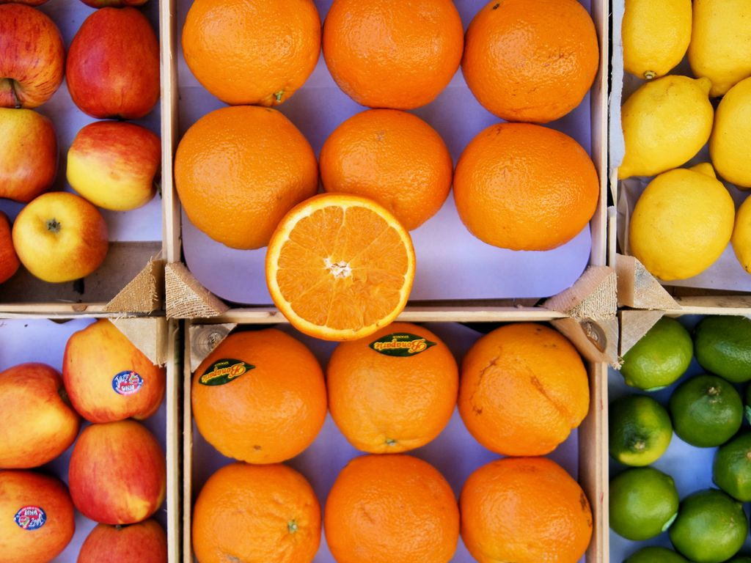
THE CHALLENGES-2
HPC as a commodity? WTH?
Iaas vs PaaS
Security models
SLA e QoS
Photo by Hindrik S - Creative Commons Attribution-NonCommercial-ShareAlike License http://www.flickr.com/photos/63991153@N00
Created with Haiku Deck

Slide 15
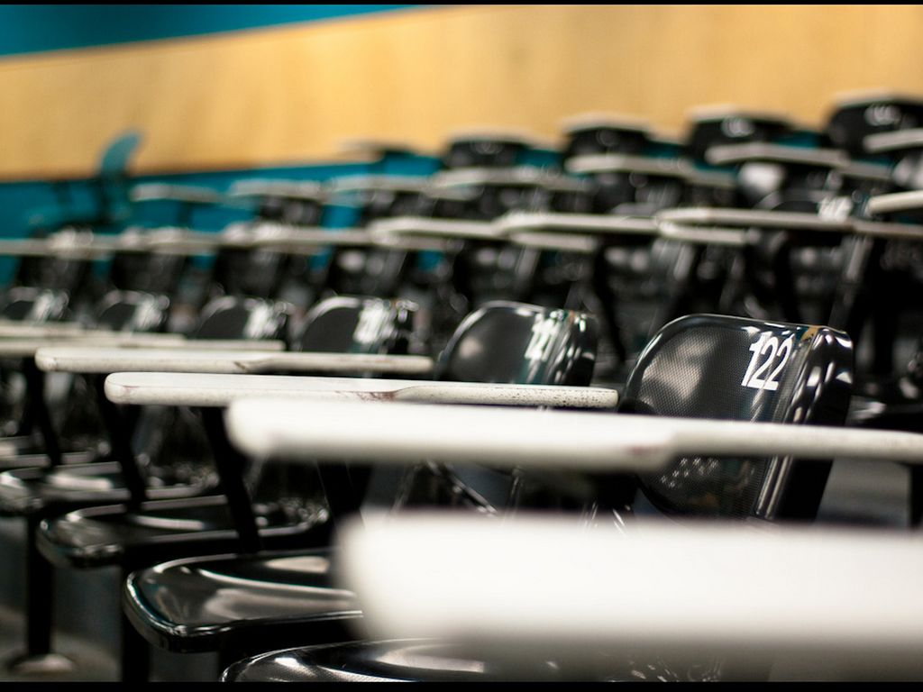
THE CHALLENGES-3
To train people in HPC adequately is a priority for EC.
Summer of HPC Program
CINECA Schools
International master in HPC (SISSA+ICTP)
Photo by Robert S. Donovan - Creative Commons Attribution License http://www.flickr.com/photos/10687935@N04
Created with Haiku Deck

Slide 16
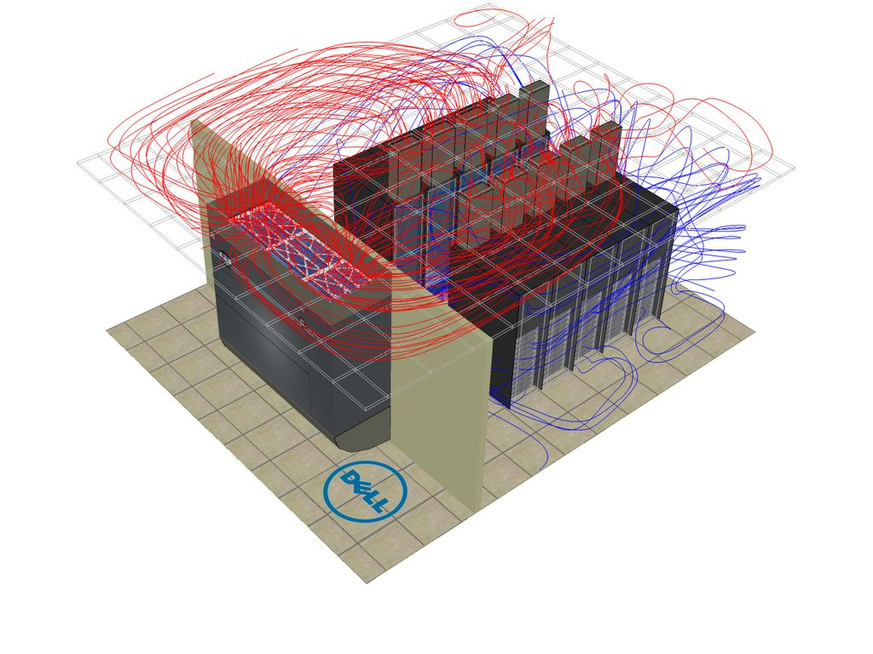
CINECA FOR INDUSTRIES
On demand technical computing service on a HPC cluster
EASY
SECURE
COMPLETE
FAST
Technical support (CFD, Visualization, DA)
International network on HPC
Photo by talk2stu - Creative Commons Attribution License http://www.flickr.com/photos/25578736@N00
Created with Haiku Deck

Slide 17
HPC IN SIX STEPS
01
02
03
Get your account on our user portal.
Upload your data on our servers.
Set your job.
04
05
06
Run the analyses.
Focus on your work, we notify when results are ready.
Start analyzing your results interactively.

Slide 18
DATA SECURITY
System access (ISO 27001)
Cyphered connection
Access policy on local file system
Differentiated access policies for industry users
Access policy on scheduler
Data Backup
Disaster recovery

Slide 19
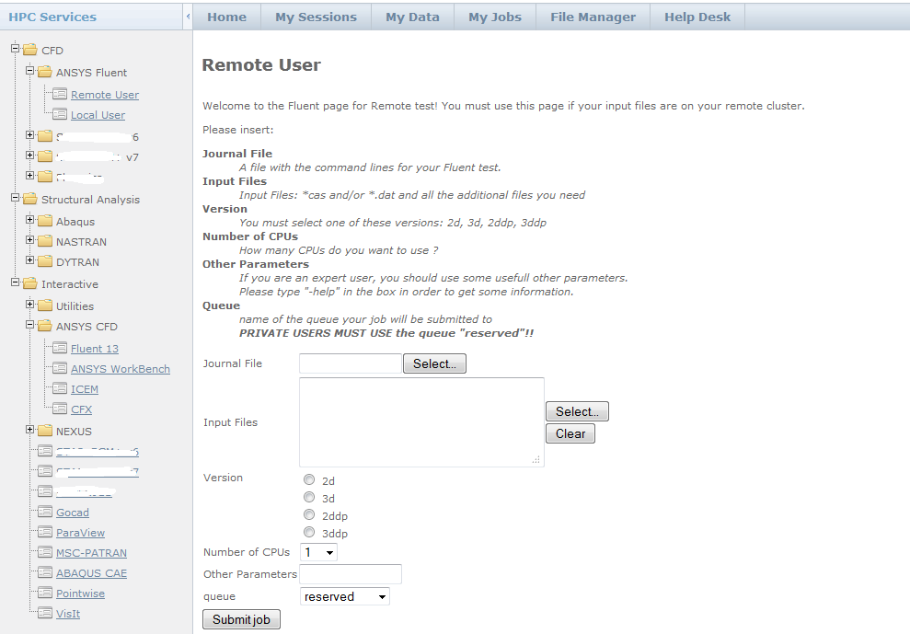

Slide 20
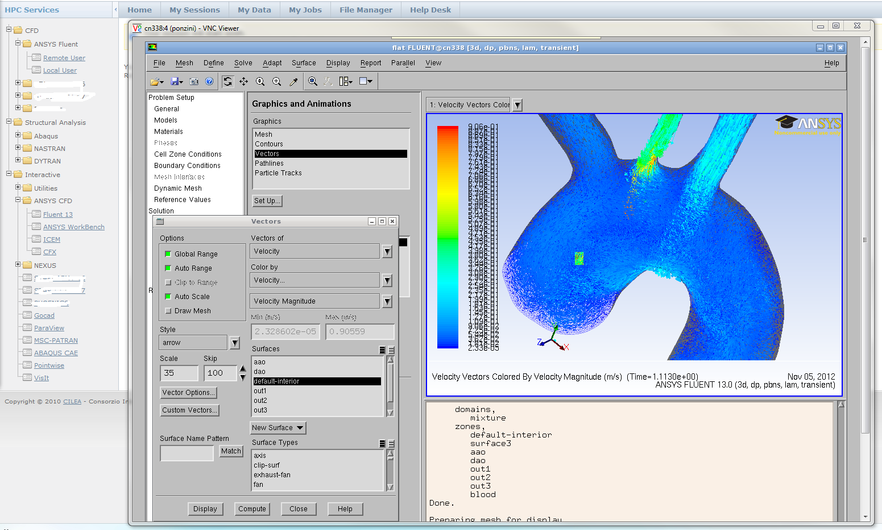

Slide 21
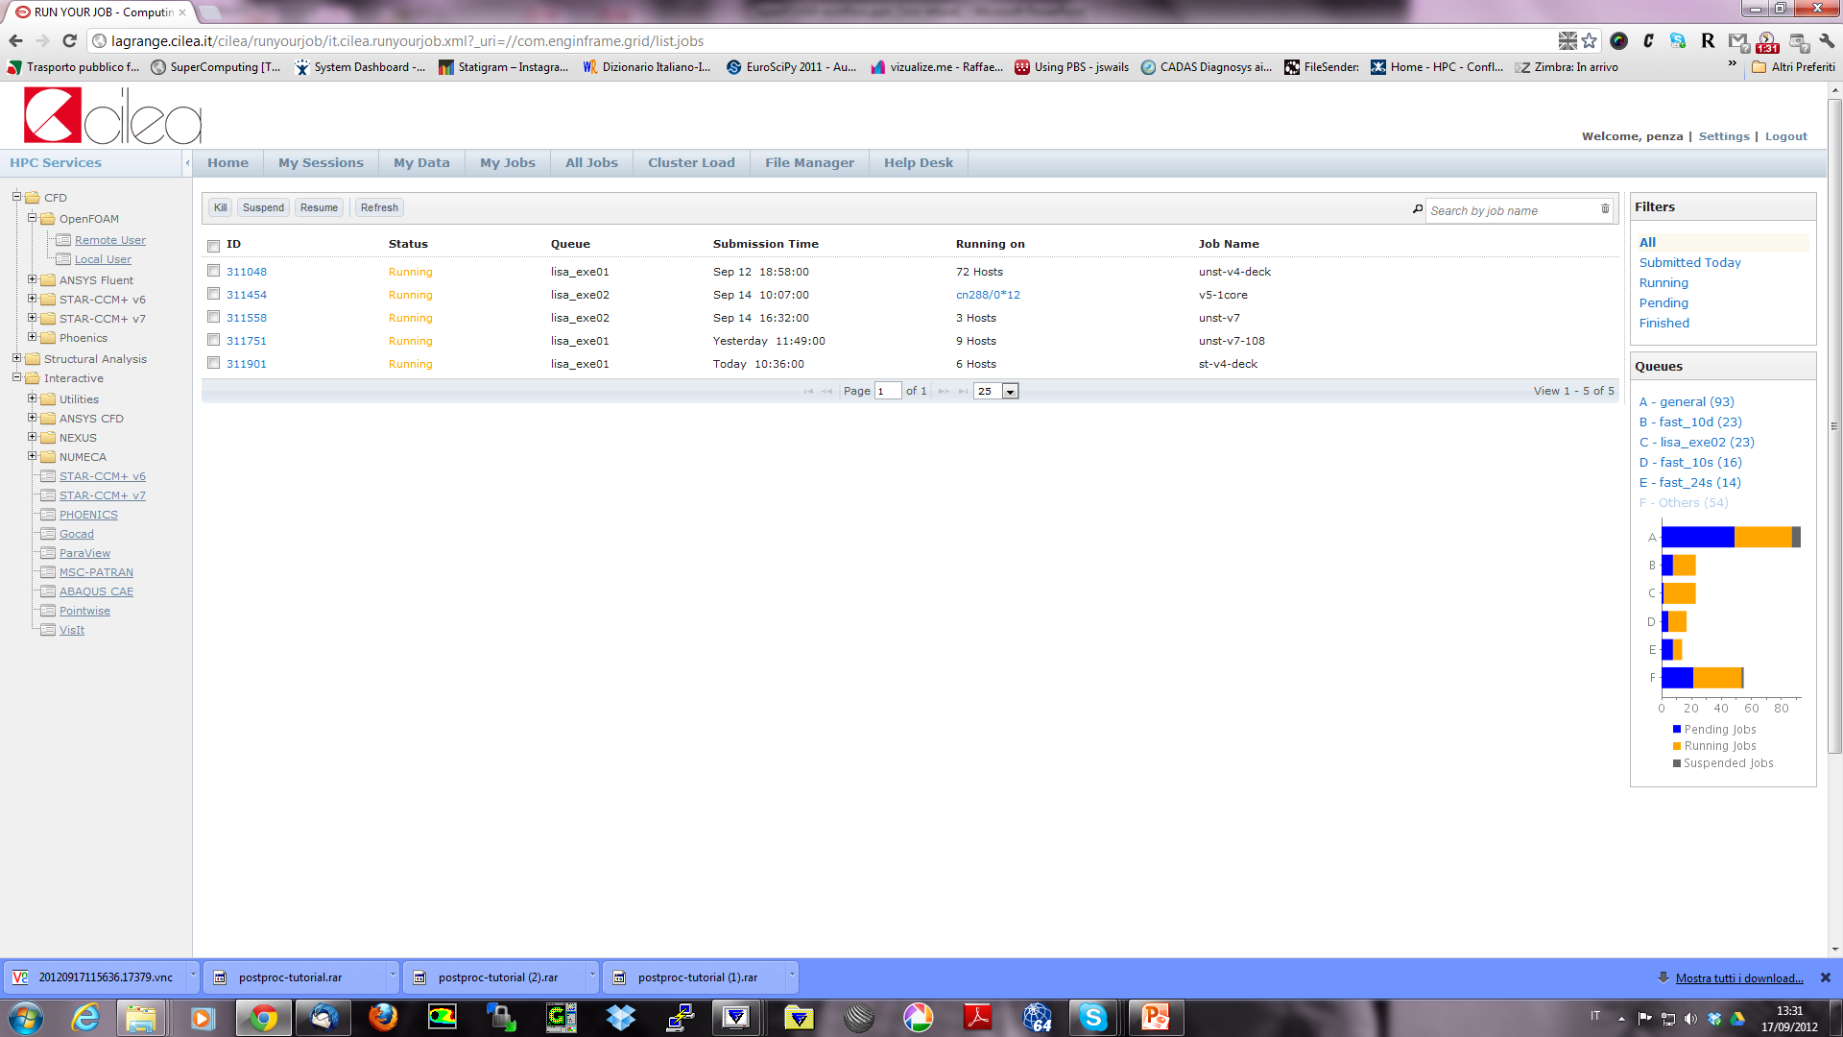
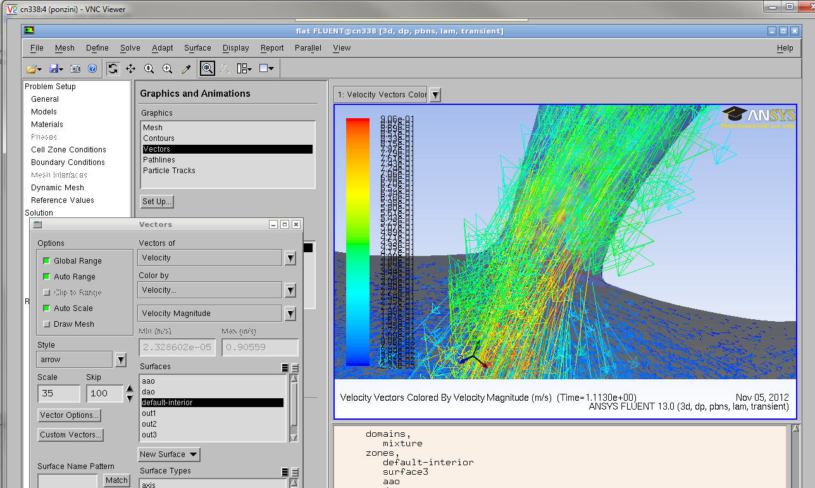

Slide 22
HPC INFRASTRUCTURE
Top500 ranked HPC infrastructure
Fermi is ranked #7 on June 2012 op500 list
Galileo is the cluster targeting CAE simulations.
>1000 Intel Haswel CPUs (8000 cores)
Green500 ranked HPC infrastructure
Eurora is ranked #1 on the June 2013 green500 list
Dedicated HW for pre/post processing CAE activity
Dedicated ‘Fat’ nodes enables the management of up to 1TB of shared RAM

Slide 23
OF & HPC: TECHNOLOGICAL CONVERGENCES
HPC Infrastructures
Moore’s Law has being reached
Multi-cores and many-cores architectures are pushing scalability efficiency
Open-Source Codes and Languages
Reliable & robust CFD libraries are now free from license limitations
Ease of use scripting languages for gluing computational workflows into automated computational experiments
Web Interfaces and Cloud Computing
Web-based services for automated workflow and collaborative experience

Slide 24
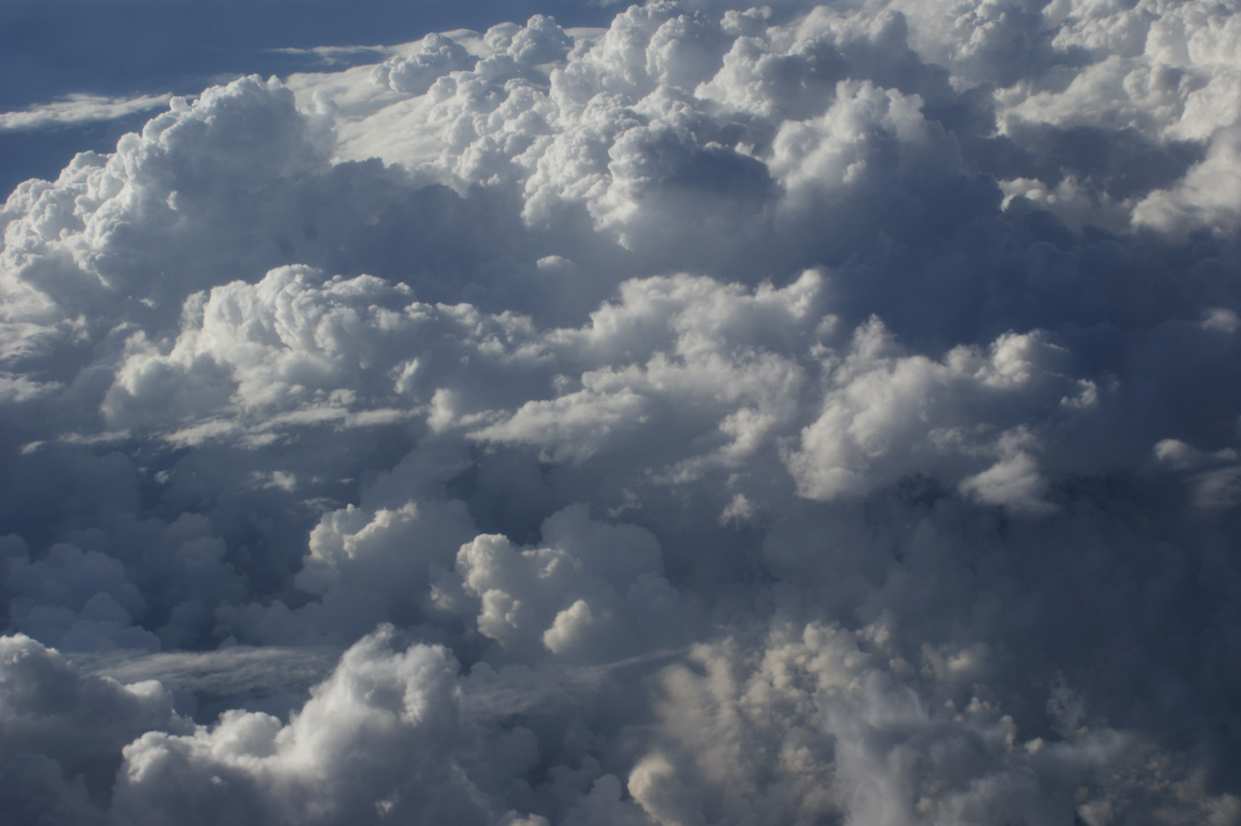
THE 3rd CFD REVOLUTION
For the first time CFD applications can be designed without any limitations concerning ISV licensing costs that in the last decades represented a well known bottle-neck.
Open-source CFD libraries are mature, robust and reliable tools that can today compete with ISV softwares in problem solving for a wide range of filed of applications in engineering and physics.
The ideal workflow able to exploit the technological convergences of open-source technologies and HPC platforms into automated and productive workflows must be re-designed.

Slide 25
AUTOMATIC & ROBUST CFD TOOLS +…
CFD analysis
State of the art computational study of fluid dynamics and thermo-fluid dynamics problems
3D complex geometries meshing
Highly automated meshing process of 3D complex shapes; fully-structured, hybrid or unstructured
Parallel CFD
High parallel CFD computations for internal flows and external aerodynamics problems
Shape optimization
Shape design optimization based on CFD data

Slide 26
…HPC = HIGHLY PRODUCTIVE COMPUTING
Tailored Scalability
Performance indices, including rating, speed-up and efficiency are evaluated for specific cases and settings
Mesh automation
Highly automated meshing is performed using scripting techniques applied to open-source and third-party software
Automatic post-processing and reporting
Post-processing, visualization and quantification are standardized into automated workflows
Web-based interfaces
Overall workflow, is available on flexible web-based technologies for a remote high productive experience

Slide 27
SCALING-UP
Our working methodology
PoC
Development
Production
Photo by Andy Magee - Creative Commons Attribution-NonCommercial License http://www.flickr.com/photos/84272941@N00
Created with Haiku Deck

Slide 28
ARE YOU READY FOR HPC*?
CAE and particularly CFD are a key factor to improve competitiveness of a manufacturing company.
HPC is an enabling technology part of innovation strategy for EU G20 countries.
OpenFOAM on HPC might boost your productivity.
We are ready to speed up your innovation.
Photo by Tc Morgan - Creative Commons Attribution-NonCommercial-ShareAlike License http://www.flickr.com/photos/63114962@N08
Created with Haiku Deck

Slide 29
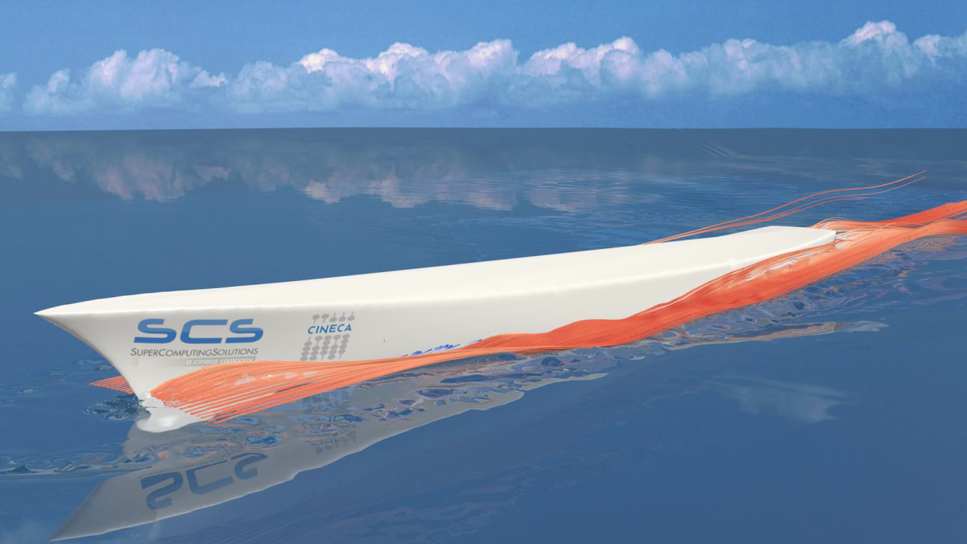
THANK YOU
Alessandro Chiarini
SCS srl
a.chiarini@scsitaly.com
www.linkedin.com/in/achiarini

