Slide 1

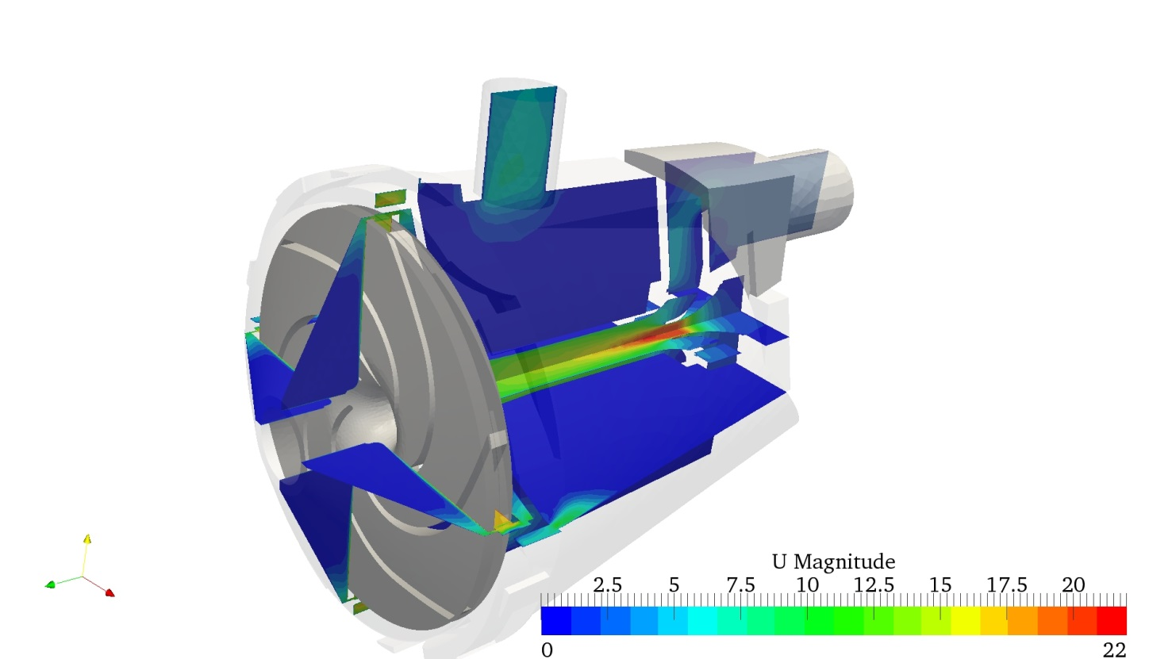
<number>
5th PRACE INDUSTRIAL EXECUTIVE SEMINAR
Open Source in Industry:
Virtual Test Bench for Centrifugal Pumps
Eng. Daniele Bucci Bologna, March 28, 2014
Notes:
<number>

Slide 2







Bologna, March 28, 2014
<number>
5th PRACE INDUSTRIAL EXECUTIVE SEMINAR
Introduction
What is LAPCOS ?
LAPCOSTM (Laboratory for collaborative engineering and simulation) is a consortium founded in 2005 qualified in engineering activities by means of advanced computational tools. The company structure is made up of the following companies:
Notes:
<number>

Slide 3
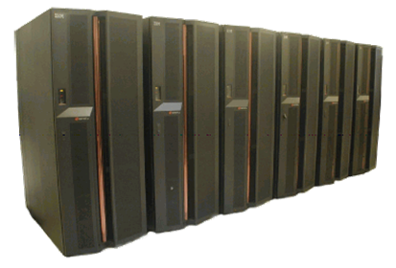

<number>
5th PRACE INDUSTRIAL EXECUTIVE SEMINAR
Introduction
A special partnership: CINECA
LAPCOS has been strongly related to CINECA as partner for HPC (especially for CFD calculations) since its foundation .
Bologna, March 28, 2014
Notes:
<number>

Slide 4
<number>
5th PRACE INDUSTRIAL EXECUTIVE SEMINAR
Introduction
LAPCOS services and tools:
Service | Tools and Skills
Engineering Mechanical 3D Design | Catia, Unigraphics, Pro-E, Solid Edge, Solid Works, Inventor, Cadenas
Structural Calculation | Nastran, Ansys, Hyperworks
Fluid Dynamic and Thermal simulation | Fluent, CFX, Open Foam
Multibodies Simulation | MSC-Adams , Recurdyn
Fatigue Behavior Prediction | Fe-Safe
Bologna, March 28, 2014
Notes:
<number>

Slide 5
<number>
5th PRACE INDUSTRIAL EXECUTIVE SEMINAR
Introduction
OpenFoam Project:
Why? The use of CFD technology in industry is still limited by the high computational time and cost, and even more by the high cost of commercial CFD software licenses.
In 2009, LAPCOS in partnership with CINECA relying on the contribute of regional research program starts to explore the Open Foam CFD capability by means of a deep training activity on the Open Foam code, Linux OS and the programming language.
Bologna, March 28, 2014
Notes:
<number>

Slide 6
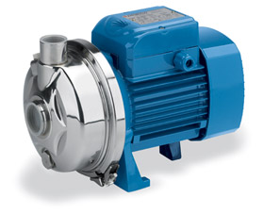

<number>
Virtual Test Bench for Centrifugal Pumps
At the end of 2011 the first project based on Open Foam was delivered
Customer:
Pedrollo is a benchmark brand world-wide for the electric water pump sector. A reputation founded on facilities, technologies, professionalism, and the company’s business model.
Pedrollo is a large, constantly growing company that extends over an area suited to a volume of production that has reached 2 million pumps a year.
The company’s facilities in fact occupy a very large and steadily expanding area that currently amounts to over 100,000 m2: dimensions that make Pedrollo an industrial district in its own right, divided into several plants, each with its own efficient structure and position in the production framework.
Bologna, March 28, 2014
5th PRACE INDUSTRIAL EXECUTIVE SEMINAR
Notes:
<number>

Slide 7

<number>
5th PRACE INDUSTRIAL EXECUTIVE SEMINAR
Virtual Test Bench for Centrifugal Pumps
Problem: improve time to market new products
Bottleneck: High computational time on CFD (several weeks) due to limited sofware license and parallel computation ( limited budget)
Solution: Customized tool to use Open Foam with multi-core parallelization to automate the CFD calculations
Bologna, March 28, 2014
5th PRACE INDUSTRIAL EXECUTIVE SEMINAR
Notes:
<number>

Slide 8
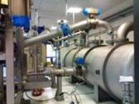
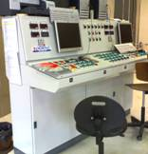
<number>
Virtual Test Bench for Centrifugal Pumps
Test bench: is the most important criteria to check the hydraulic performance for a new pump design. In particular to obtain Head (H) -Flow rate (Q) curve and efficiency
Bologna, March 28, 2014
5th PRACE INDUSTRIAL EXECUTIVE SEMINAR
Notes:
<number>

Slide 9
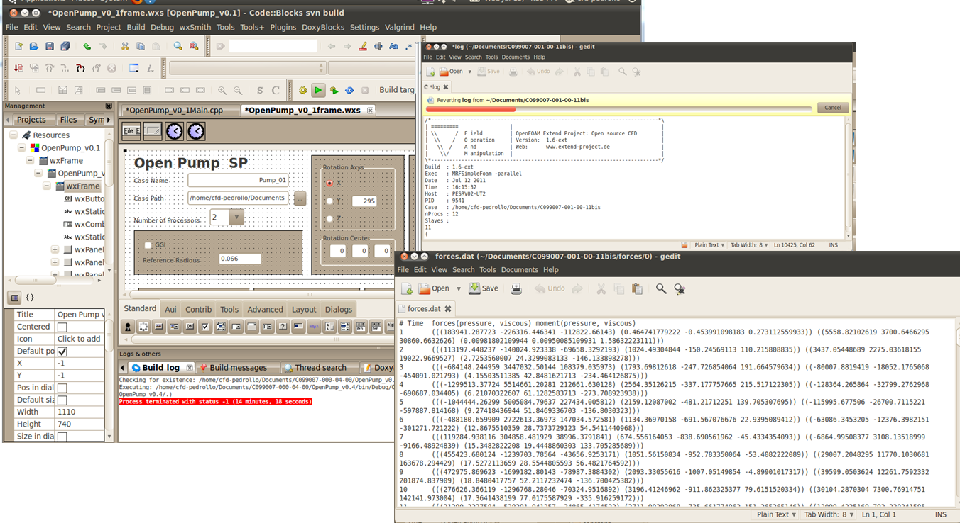
<number>
Virtual Test Bench for Centrifugal Pumps
Open Pump: developed software tool for setting OpenFoam cases and submitting jobs.
Bologna, March 28, 2014
5th PRACE INDUSTRIAL EXECUTIVE SEMINAR
Notes:
<number>

Slide 10
<number>
Virtual Test Bench for Centrifugal Pumps
OpenPump description
OpenPump is a pre-processing and a quantitative post processing software for centrifugal pumps CFD simulations
It works with OpenFOAM ( first version with 1.6-ext 2010, upgraded to 2.1 on 2013) which is its solver software.
OpenPum has been conceived to perform several CFD calculation in a row on the same geometry
OpenPump aims at providing the analyst with the pumping curve (pressure drop over volume flow) automatically starting from the mesh file and the pumping parameters (rpm and volume flows)
OpenPump automatically chooses when the solver reaches convergence criteria for the actual calculation by means of a coupling algorithm with OpenFOAM then jumps to the next simulation scheduled.
Bologna, March 28, 2014
5th PRACE INDUSTRIAL EXECUTIVE SEMINAR

Slide 11


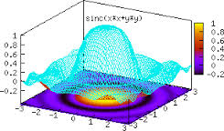

<number>
Virtual Test Bench for Centrifugal Pumps
OpenPump software tools
GnuPlot
Bologna, March 28, 2014
5th PRACE INDUSTRIAL EXECUTIVE SEMINAR

Slide 12
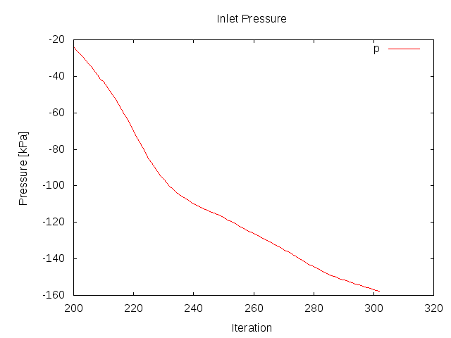
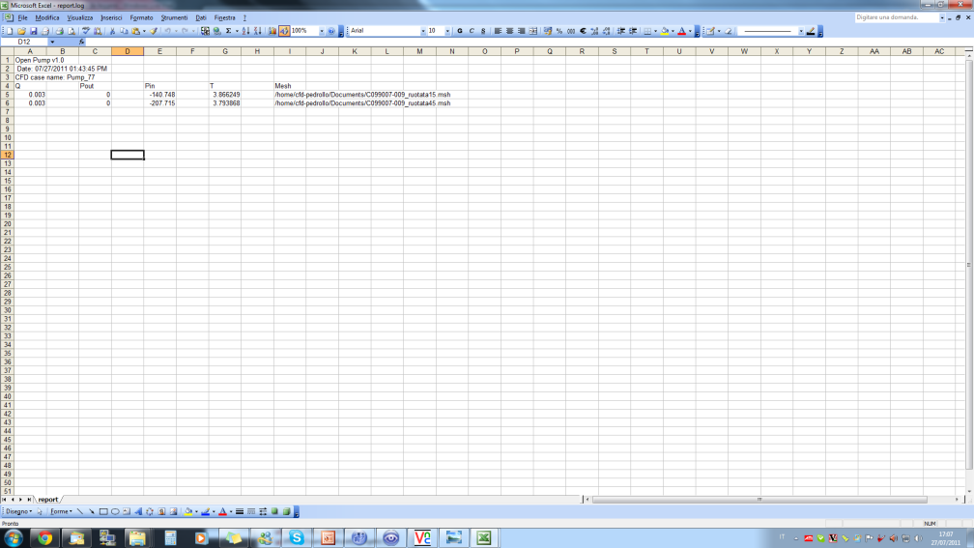
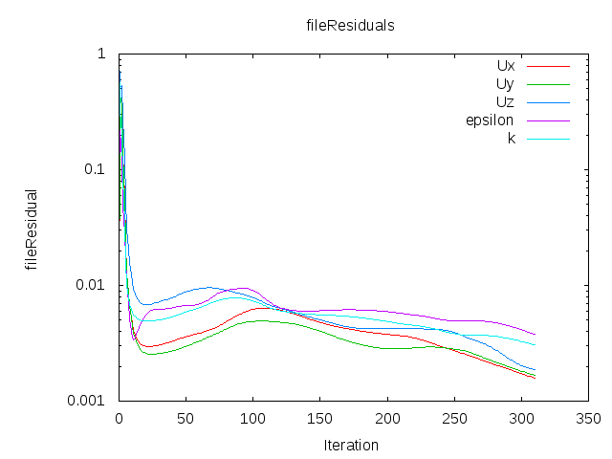
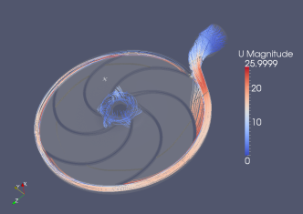
<number>
Virtual Test Bench for Centrifugal Pumps
How OpenPump works
OpenPump
1- Creates OF case and dictionaries
2- Converts mesh
3- Checks convergence, stop current run and perform next run
4- Creates run logs and residual plot
5- Creates output files
CFD Analyst
Pumping parameters
OpenFOAM case
OpenFOAM
Runs
MRFPisoFoam
Convergence parameters
ANSYS Mesher
mesh.msh
Outputs
1- Residuals, pressure, torque plots
2- Summary log of the executables launched
3- Summary log of each run:
Pressure on inlet and outlet surfaces
Torque on rotor walls
3- VTK format of fluid dynamics fields for
Graphical post-processing by means of
Paraview
Bologna, March 28, 2014
5th PRACE INDUSTRIAL EXECUTIVE SEMINAR

Slide 13
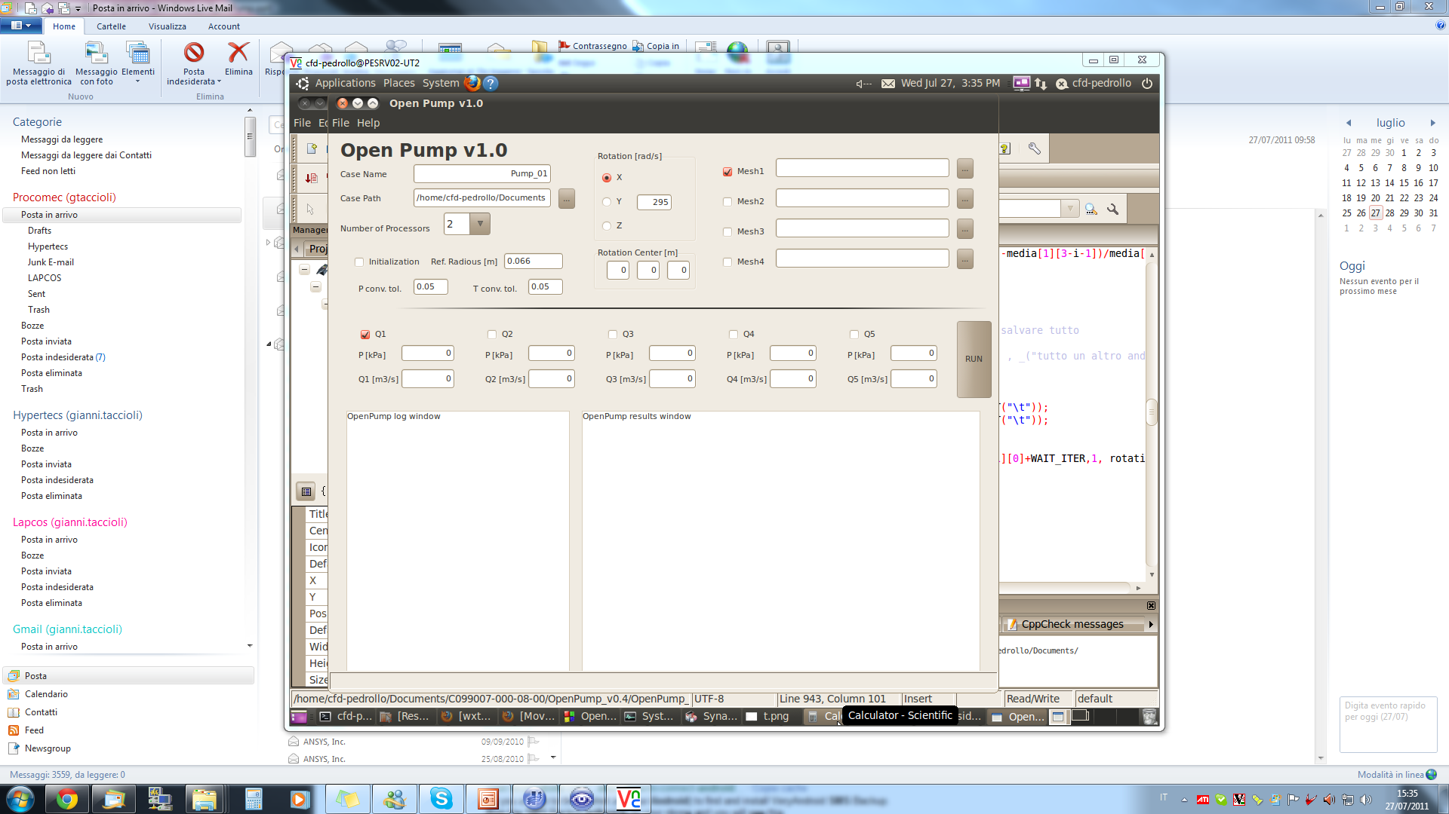
<number>
Virtual Test Bench for Centrifugal Pumps
OpenPump GUI 1.0
Multicore parameter
Up to 4
different
meshes
Convergence criteria
Up to 5
flow per each mesh
Log windows
Bologna, March 28, 2014
5th PRACE INDUSTRIAL EXECUTIVE SEMINAR

Slide 14
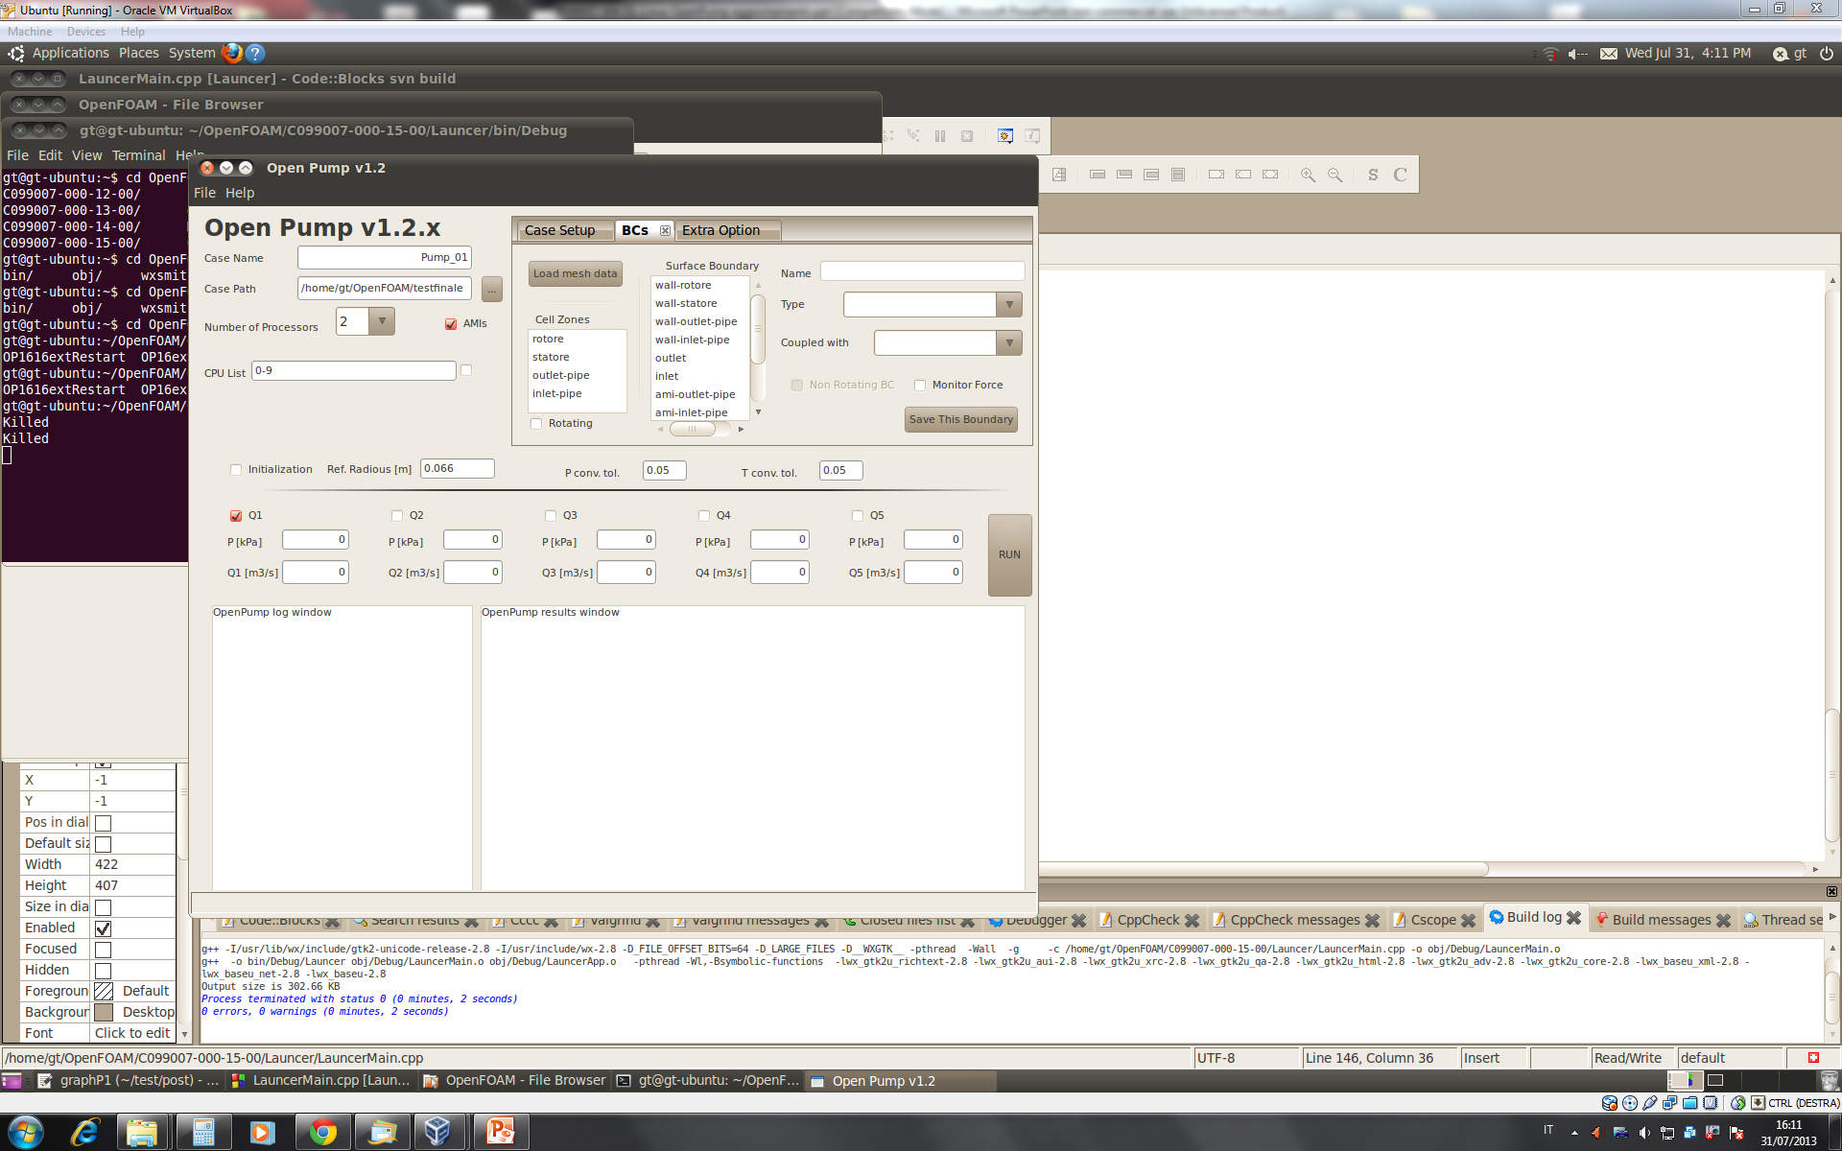
<number>
Virtual Test Bench for Centrifugal Pumps
OpenPump GUI 1.2.x (BCs and AMI improvements)
Bologna, March 28, 2014
5th PRACE INDUSTRIAL EXECUTIVE SEMINAR

Slide 15
<number>
Virtual Test Bench for Centrifugal Pumps
OpenPump achievements
OpenPump has been developed to work with a modified OpenFoam executable solver: MRFPisoFoam created by means of modification of the standard MRFSimpleFoam solver that does not allow quick convergence. MRFPisoFoam provides with a stronger pressure-velocity coupling and has been found more suitable to deal with centrifugal pumps simulations.
OpenPump is highly user-friendly tool because of its simple Graphical User Interface
OpenPump allows modifications of its code in order to meet new customer requirements in terms of:
New OpenPump/OpenFoam-solvers coupling
Other engineering CFD applications than centrifugal pumps
OpenPump enormously increases its potential on HPC systems.
Bologna, March 28, 2014
5th PRACE INDUSTRIAL EXECUTIVE SEMINAR

Slide 16
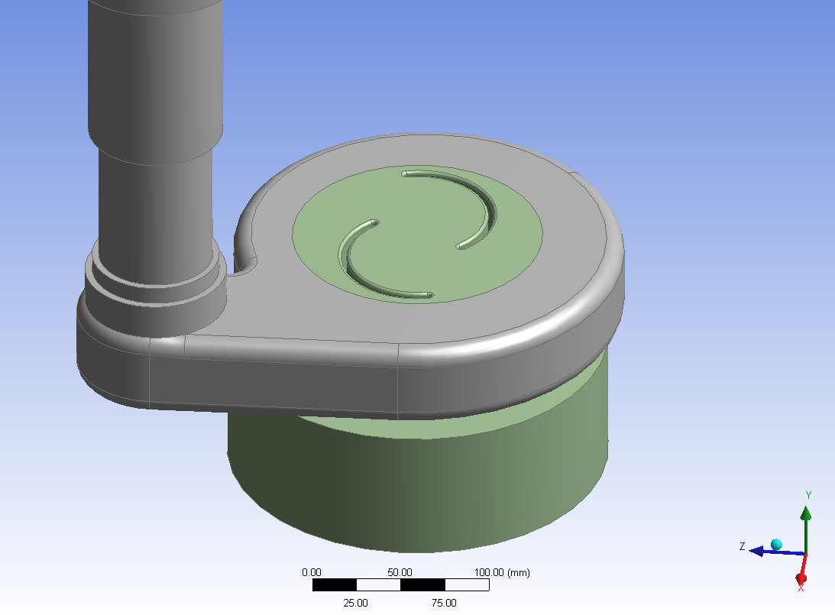
<number>
Virtual Test Bench for Centrifugal Pumps
Benchmark example ( to validation Open Foam results)
ANSYS MESHER
GGI
TETRAEDRICA
3715612 celle
Skewness max 0.84
Skewness media 0.22
 | Ordine Accuratezza | ingresso | Uscita | Girante
CFX | Primo ordine | p = 0 Pa relativi | V = 0.43 m/s | 2820 rpm
OF | Upwind (primo ordine) | p = 0 Pa relativi | V = 0.43 m/s | 2820 rpm
Bologna, March 28, 2014
5th PRACE INDUSTRIAL EXECUTIVE SEMINAR
Notes:
<number>

Slide 17
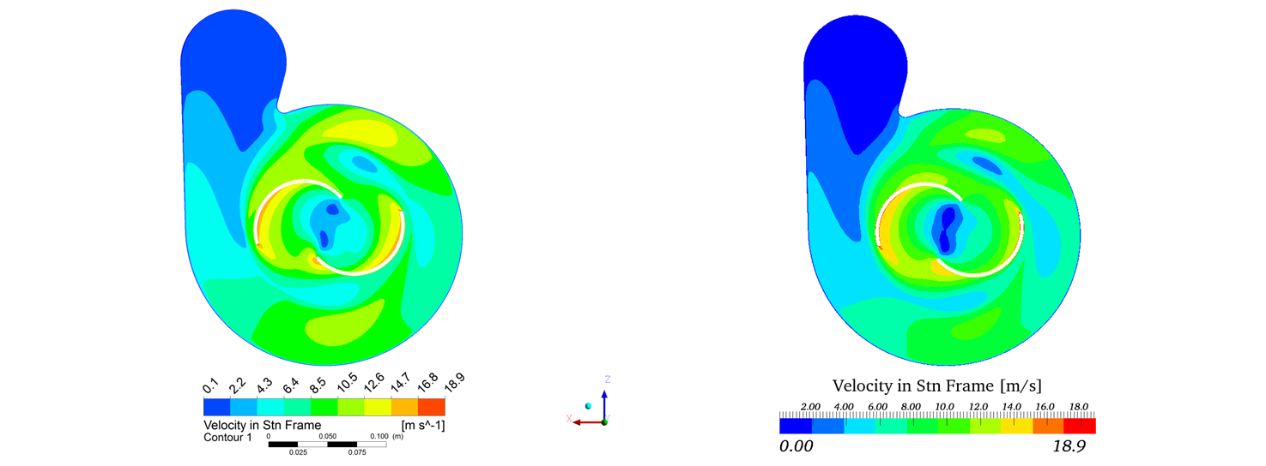

<number>
Virtual Test Bench for Centrifugal Pumps
Benchmark example
Bologna, March 28, 2014
5th PRACE INDUSTRIAL EXECUTIVE SEMINAR
Notes:
<number>

Slide 18
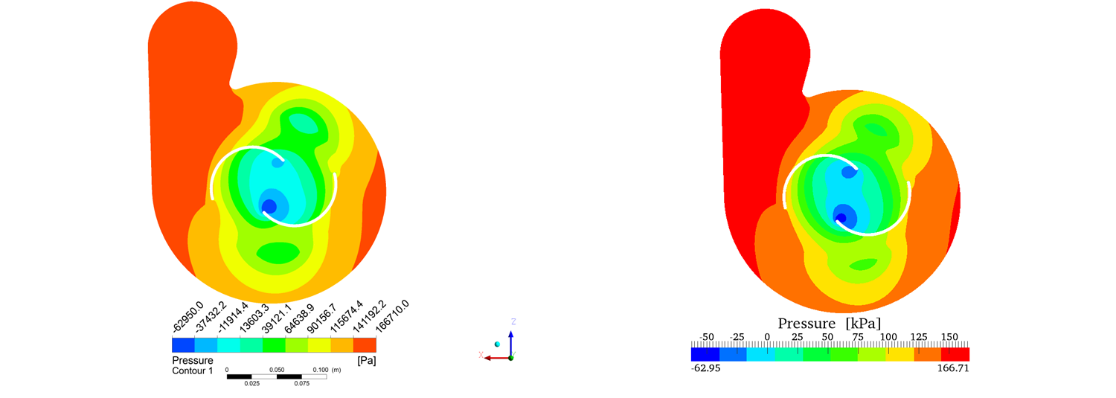

<number>
Virtual Test Bench for Centrifugal Pumps
Benchmark example
Bologna, March 28, 2014
5th PRACE INDUSTRIAL EXECUTIVE SEMINAR
Notes:
<number>

Slide 19
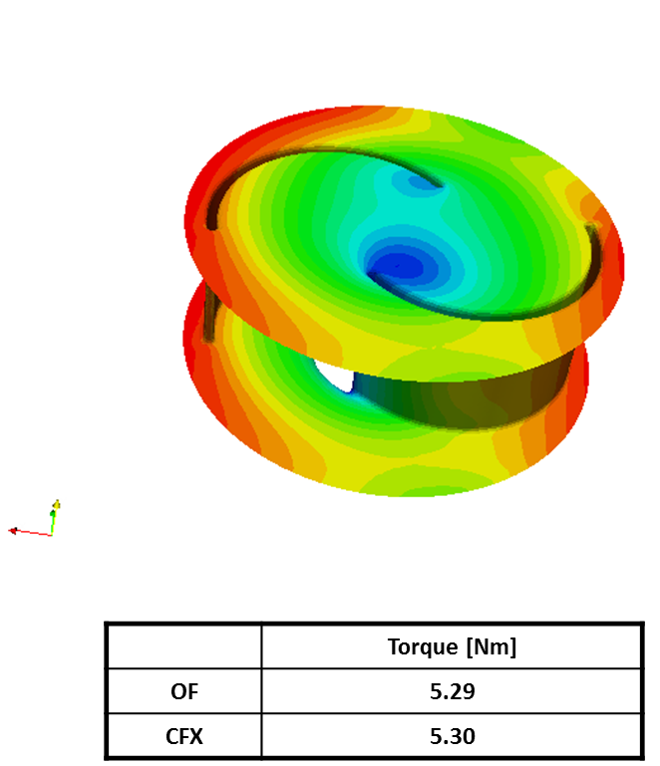
<number>
Virtual Test Bench for Centrifugal Pumps
Benchmark example
Bologna, March 28, 2014
5th PRACE INDUSTRIAL EXECUTIVE SEMINAR
Notes:
<number>

Slide 20
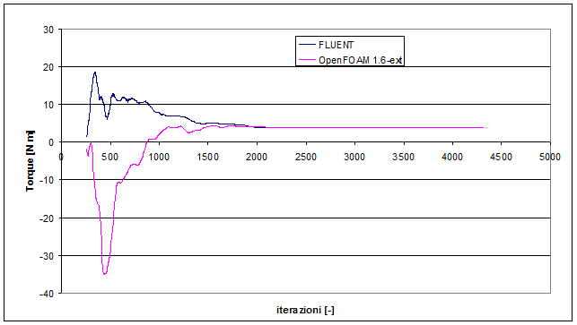
<number>
Virtual Test Bench for Centrifugal Pumps
Benchmark example (convergence speed)
Bologna, March 28, 2014
5th PRACE INDUSTRIAL EXECUTIVE SEMINAR
Notes:
<number>

Slide 21
<number>
Virtual Test Bench for Centrifugal Pumps
Scalability Test
Bologna, March 28, 2014
5th PRACE INDUSTRIAL EXECUTIVE SEMINAR
Notes:
<number>

Slide 22
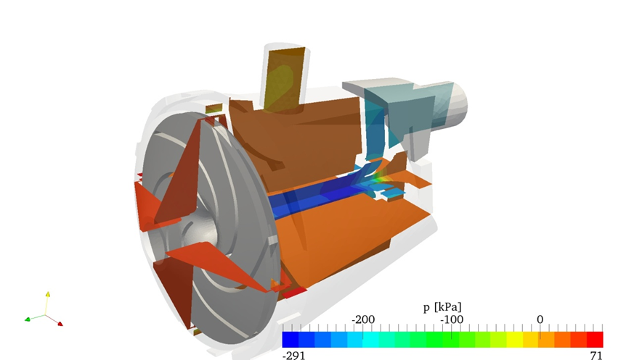

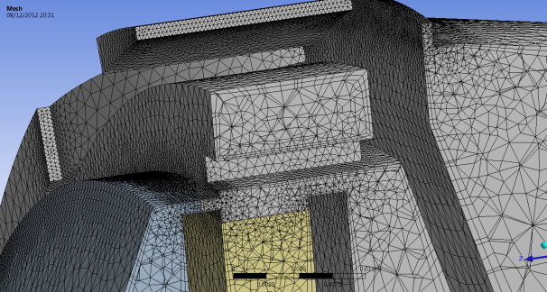
<number>
Virtual Test Bench for Centrifugal Pumps
Improvements in progress:
Implementation of Open Foam 2.1.x
Implementation of Transient Analysis
Arbitrary mesh interface
Install Open Pump (jobs manager) on CINECA HPC
Bologna, March 28, 2014
5th PRACE INDUSTRIAL EXECUTIVE SEMINAR
Notes:
<number>

Slide 23
<number>
Virtual Test Bench for Centrifugal Pumps
Thank you for listening
daniele.bucci@lapcos.it
gianni.taccioli@lapcos.it
LAPCOS Scrl
Bologna, March 28, 2014
5th PRACE INDUSTRIAL EXECUTIVE SEMINAR
Notes:
<number>

