Slide 1
CUDA Efficient Programming
f.ficarelli@cineca.it

Slide 2
Agenda
Overview and general concepts
Performance Metrics
Memory Optimizations
Execution Optimization
Tools Overview

Slide 3
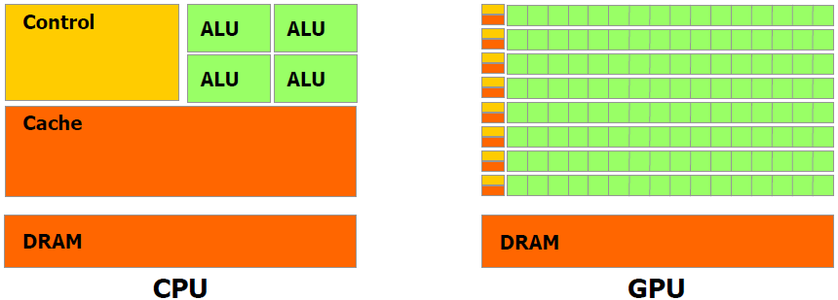
Different worlds: host and device
 | Host | Device
Threading resources | 2 threads per core (SMT), 24/32 threads per node. The thread is the atomic execution unit. | e.g.: 1536 (thd x sm) * 14 (sm) = 21504. The Warp (32 thd) is the atomic execution unit.
Threads | «Heavy» entities, context switches and resources management. | Extremely lightweight, managed grouped into warps, fast context switch, no resources management (statically allocated once).
Memory | e.g.: 48 GB / 32 thd = 1.5 GB/thd, 300 cycles lat., 6.4 GB/s band (DDR3), 3 caching levels with lots of speculation logic. | e.g.: 6 GB / 21504 thd = 0.3 MB/thd, 600 cycles lat*, 144 GB/s band (GDDR5)*, fake caches. * coalesced

Slide 4
Maximum performance benefit
Focus on achieving high occupancy.
Focus on how to exploit the SIMT model at its best.
Deeply analyze your algorithm in order to find the hotspots and embarassingly parallel-enabled portions.
i.e.: pay attention to the Amdahl’s law, the porting could
be very tough.
$$S=\frac{1}{\left(1−P\right)+P/N}$$

Slide 5
Capability
The version tag that identifies:
instructions and features supported by the board;
coalescing rules;
the board’s resources constraints;
througput of some instructions (hardware implementation).

Slide 6
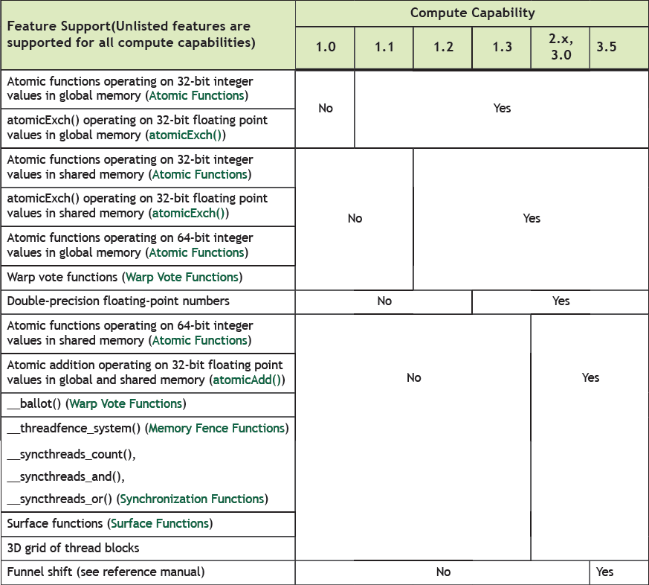
Capability: atomics

Slide 7
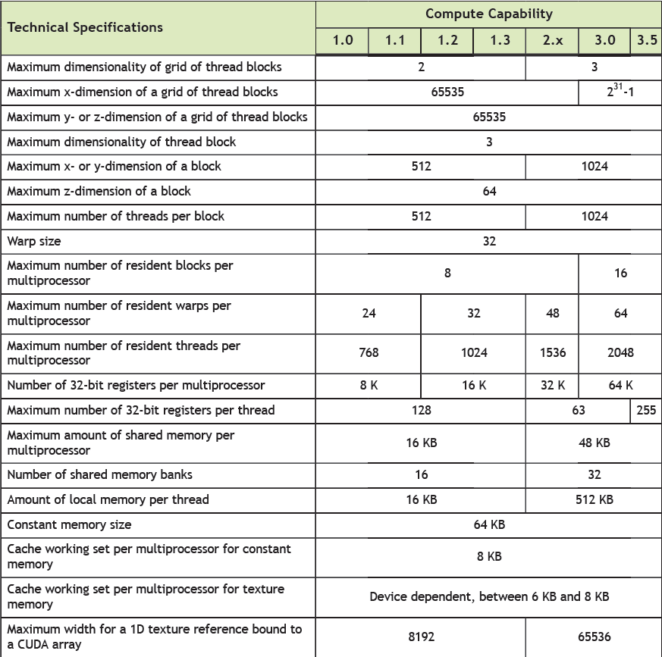
Capability: resources constraints

Slide 8
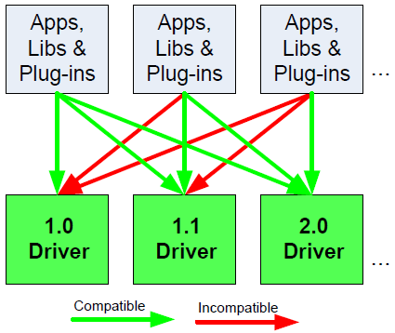
CUDA APIs
Runtime API | Handles kernel mechanics (loading, parameters setup, invocation, context management, fatbin management). Provides CUDA language extensions.
Driver API | Low level, pure C99 interface (nvcc not needed), explicit management of every resource (context, kernel params, etc…)
The Driver API isn’t forward compatible.

Slide 9
Performance metrics

Slide 10
Performance metrics
Wall time
Theroetical vs achieved bandwidth
Achievable vs achieved occupancy
Memory conflicts

Slide 11
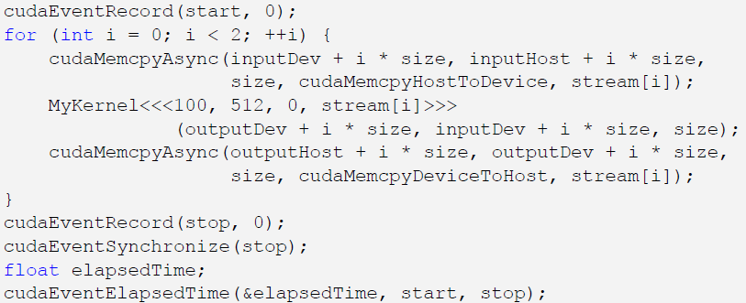
Timing
It’s allowed to use std timing facilities (host side).
Beware of asynchronous calls!
CUDA provides the Events facility.
Needed to time single streams without loosing concurrency.
start = clock()
my_kernel<<< g, b, s >>>();
cudaThreadSynchronize();
end = clock();

Slide 12
Bandwidth
Get board’s theoretical bandwidth:
transfer channel width (bits)
DDR
$$B=freq ∗rate=\left(1107 ∗ {10}^{6}\right)∗\left(\frac{512 ∗2}{8}\right)=141.6 GB/s$$
GeForce GTX 280
clock freq. (MHz)
Get kernel’s effective bandwidth:
// __global__ device code, single precision data
if( threadIdx.x < 2048 && threadIdx.y < 2048 ) {
mat_a[ threadIdx.x ] [ threadIdx.y ] = mat_b[ threadIdx.x ] [ threadIdx.y ];
}
$$B^{∗}=\frac{D^{r}+D^{w}}{t}=\frac{{2048}^{2} ∗4 ∗2}{t}$$
Measure kernel’s achieved bandwidth: use profiling tools!
Beware of cudaprof: throughput result is extrapolated and considers wasted transaction data (uncoalesced) as good.

Slide 13
Memory Optimizations

Slide 14
Data Transfers
Host and Device have their own address space
GPU boards are connected to host via PCIex bus
Low bandwidth, extremely low latency
Focus on how to minimize transfers and copybacks*.
Technology | Peak Bandwidth
PCIex GEN2 (16x, full duplex) | 8 GB/s (peak)
PCIex GEN3 (16x, full duplex) | 16 GB/s (peak)
DDR3 (full duplex) | 26 GB/s (single channel)
* Try to find a good trade off!

Slide 15
Page-locked memory
Pinned (or page-locked memory) is a main memory area that is not pageable by the operating system;
ensures faster transfers (the DMA engine can work without raising interrupts);
the only way to get closer to PCI peak bandwidth;
allows CUDA asynchronous operations (including Zero Copy) to work correctly.
// allocate page-locked memory
cudaMallocHost(&area, sizeof(double) * N);
// free page-locked memory
cudaFreeHost(area);
// allocate regular memory
area = (double*) malloc( sizeof(double) * N );
// lock area pages (CUDA >= 4.0)
cudaHostRegister( area, sizeof(double) * N, cudaHostRegisterPortable );
// unlock area pages (CUDA >= 4.0)
cudaHostUnregister(area);
// free regular memory
cudaFreeHost(area);
Warning: locked pages are a limited resource (much smaller than regular pages, ulimit -l)

Slide 16
Zero Copy
CUDA allows to map a page-locked host memory area to device’s address space;
The only way to provide on-the-fly a kernel data larger than device’s global memory.
Very convenient for large data with sparse access pattern.
// allocate page-locked and mapped memory
cudaHostAlloc(&area, sizeof(double) * N, cudaHostAllocMapped);
// invoke retrieving device pointer for mapped area
cudaHostGetDevicePointer( &dev_area, area, 0 );
my_kernel<<< g, b >>>( dev_area );
// free page-locked and mapped memory
cudaFreeHost(area);

Slide 17
Unified Virtual Addressing
CUDA 4.0 introduced one (virtual) address space for all CPU and GPUs memory:
automatically detects physical memory location from pointer value
enables libraries to simplify their interfaces (e.g. cudaMemcpy)
Pre-UVA | UVA
Each source-destination permutation has its own option | Same interface
cudaMemcpyHostToHost cudaMemcpyHostToDevice cudaMemcpyDeviceToHost cudaMemcpyDeviceToDevice | cudaMemcpyDefault
Pointers returned by cudaHostAlloc() can be used directly from
within kernels running on UVA enabled devices (i.e. there is no
need to obtain a device pointer via cudaHostGetDevicePointer())

Slide 18
Multi-GPUs: P2P
cudaDeviceCanAccessPeer(&can_access_peer_0_1, gpuid_0, gpuid_1);
cudaDeviceCanAccessPeer(&can_access_peer_1_0, gpuid_1, gpuid_0);
cudaSetDevice(gpuid_0);
cudaDeviceEnablePeerAccess(gpuid_1, 0);
cudaSetDevice(gpuid_1);
cudaDeviceEnablePeerAccess(gpuid_0, 0);
cudaMemcpy(gpu0_buf, gpu1_buf, buf_size, cudaMemcpyDefault);
cudaMemcpy() knows that our buffers are on different devices (UVA), will do a P2P copy now
Note that this will transparently fall back to a normal copy through the host if P2P is not available

Slide 19
Multi-GPUs: direct access
__global__ void SimpleKernel(float *src, float *dst)
{
const int idx = blockIdx.x * blockDim.x + threadIdx.x;
dst[idx] = src[idx];
}
cudaDeviceCanAccessPeer(&can_access_peer_0_1, gpuid_0, gpuid_1);
cudaDeviceCanAccessPeer(&can_access_peer_1_0, gpuid_1, gpuid_0);
cudaSetDevice(gpuid_0);
cudaDeviceEnablePeerAccess(gpuid_1, 0);
cudaSetDevice(gpuid_1);
cudaDeviceEnablePeerAccess(gpuid_0, 0);
cudaSetDevice(gpuid_0);
SimpleKernel<<<blocks, threads>>> (gpu0_buf, gpu1_buf);
SimpleKernel<<<blocks, threads>>> (gpu1_buf, gpu0_buf);
cudaSetDevice(gpuid_1);
SimpleKernel<<<blocks, threads>>> (gpu0_buf, gpu1_buf);
SimpleKernel<<<blocks, threads>>> (gpu1_buf, gpu0_buf);
After P2P initialization, this kernel can now read and write data in the memory of multiple GPUs (just deferencing pointers!)
UVA ensures that the kernel knows whether its argument is from local memory, another GPU or zero-copy from the host

Slide 20
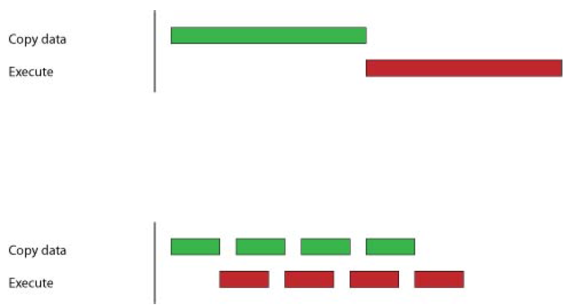
Asynchronous operations
Kernel calls are asynchronous by default
Memory transfers and copybacks are blocking
The cudaMemcpy has an asynchronous version (cudaMemcpyAsync)
Boards <= 1.3 can overlap copy-copy (opposite directions) and copy-kernel
Boards >= 2.0 (Fermi and Kepler) can overlap kernel-kernel execution.
// First transfer
cudaMemcpyAsync(inputDevPtr, hostPtr, size, cudaMemcpyHostToDevice, 0);
// First invocation
MyKernel<<<100, 512, 0, 0>>> (outputDevPtr, inputDevPtr, size);
// Second transfer
cudaMemcpyAsync(inputDevPtr2, hostPtr2, size, cudaMemcpyHostToDevice, 0);
// Second invocation
MyKernel2<<<100, 512, 0, 0>>> (outputDevPtr2, inputDevPtr2, size);
// Wrapup
cudaMemcpyAsync(hostPtr, outputDevPtr, size, cudaMemcpyDeviceToHost, 0);
cudaMemcpyAsync(hostPtr2, outputDevPtr2, size, cudaMemcpyDeviceToHost, 0);
cudaThreadSyncronize();

Slide 21
Streams
A stream is a FIFO command queue;
a stream is independent to every other active stream;
CUDA streams are the main way to exploit concurrent execution and I/O operations.

Slide 22
CUDA Streams
cudaStream_t stream[3];
for (int i=0; i<3; ++i) cudaStreamCreate(&stream[i]);
float* hostPtr;
cudaMallocHost((void**)&hostPtr, 3 * size);
for (int i=0; i<3; ++i) cudaMemcpyAsync(inputDevPtr+i*size, hostPtr + i * size, size, cudaMemcpyHostToDevice, stream[i]);
for (int i=0; i<3; ++i) myComputeKernel<<<100, 512, 0, stream[i]>>>(outputDevPtr + i * size, inputDevPtr + i * size, size);
for (int i=0; i<3; ++i) cudaMemcpyAsync(hostPtr + i * size, outputDevPtr+i*size, size, cudaMemcpyDeviceToHost, stream[i]);
cudaThreadSynchronize();
for (int i=0; i<3; ++i) cudaStreamDestroy(&stream[i]);
Copyback
Kernel
Transfer
Stream #1
Copyback
Kernel
Transfer
Stream #2
Copyback
Kernel
Transfer
Stream #3
time

Slide 23
Streams: how to overlap kernels
Starting from capability 2.0 the board has the ability to overlap computations from multiple kernels where:
submission of commands happens in a breadth-first fashion*;
no synchronization happens between command stages;
no operations occur on the default stream;
the active streams are less than 16*;
*Kepler architecture introduced the HyperQ technology:
No more need for breadth-first command submission
Supports up to 32 concurrent streams

Slide 24
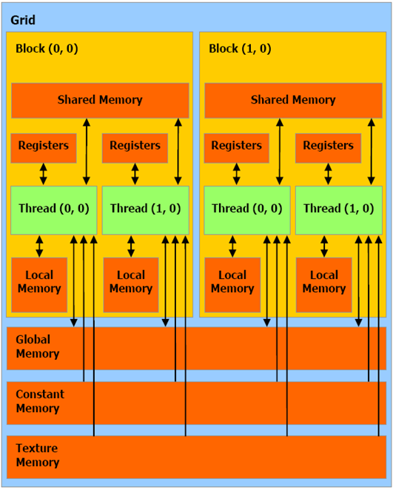
CUDA Memory Hierarchy

Slide 25
Global Memory
Memory area with the same purpose as host’s main memory;
High(er) bandwidth, high(er) latency;
In order to exploit its bandwidth at best, all accesses must be coalesced.

Slide 26
Optimizations : coalescing
The global memory is accessed by 16 threads coalesced if the following three conditions are met:
either 4-byte words, resulting in one 64-byte memory transaction
Or 8-byte words, resulting in one 128-byte memory transaction
Or 16-byte words, resulting in two 128-byte memory transactions
All 16 words must lie in the same aligned segment
Threads must access the words in a strictly increasing sequence: the n^{th} thread in the half-warp must access the n^{th} word.

Slide 27
Optimizations: coalescing, examples: OK

Slide 28
Optimizations: coalescing, examples: NON-OK
Non sequential memory access, resulting in 16 memory accesses
The starting address is misaligned, the result is 16 memory accesses

Slide 29
Optimizations: coalescing (5), examples: NON-OK
Non-contiguos access will result in 16 memory accesses

Slide 30
Coalescing for Capability 1.2
The memory controller of 1.2 cards is much improved, access as that in figure would occur in a single transaction

Slide 31
Coalescing for Capability 1.2
Random access within a segment: single 64B transaction (if they fit)

Slide 32
Capability 1.2
Hits misaligned, anyway, occur in a single transaction

Slide 33
Capability 1.2
Misaligned accesses, ending in 2 different 64B segments occur in two transactions

Slide 34
Coalescing for latest architectures
The memory controller has been vastly improved:
*L1: 128B-aligned, 128B wide lines.
**half-warp based for previous architectures.
On devices with capability >= 2.0, memory accesses by the threads of a warp** are coalesced into the minimum number of L1 lines* that satisfies all threads.

Slide 35
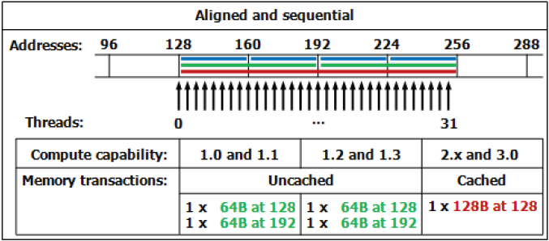
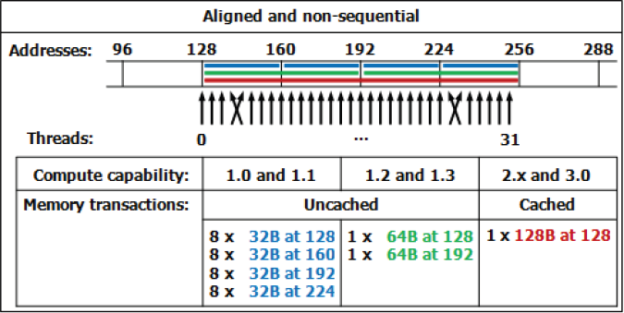
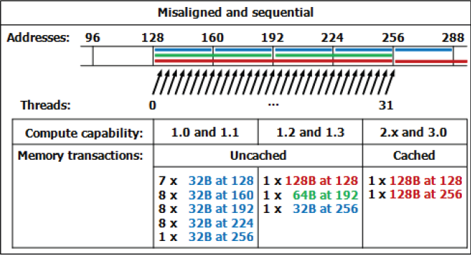
Coalescing: examples

Slide 36
Shared memory
A sort of explicit cache;
resides on the chip so it is much faster than the on-board memory;
size is 16KB (48KB on Fermi by default*)
16 (32 for Fermi) banks can be accessed simultaneously by the same warp;
Banks are organized such that:
successive 32-bit words are assigned to successive banks;
each bank has 32-bit per cycle bandwidth.
*Kepler architecture introduced some improvements:
ability to switch from 4B to 8B banks
(2x bandwidth for double precision codes)

Slide 37
Shared Memory: bank conflicts
If at least two threads belonging to the same half-warp (whole warp for capability 1.0) access the same shared memory bank, then the accesses are serialized (groups transactions in conflict-free accesses);
If all the threads access the same address, a broadcast is performed;
If part of the half-warp accesses the same address, a multicast is performed (capability >= 2.0);

Slide 38
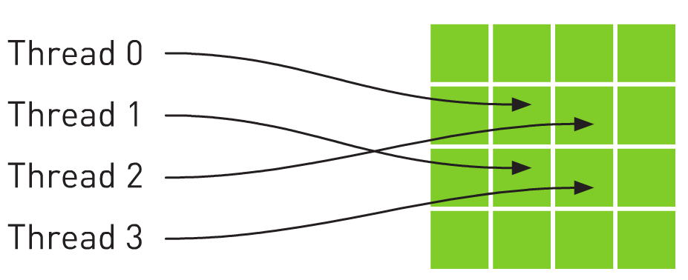
Texture memory
Load requests are cached;
it is read only, must be set by the host;
could bring benefits if the threads within the same block access memory using regular 2D patterns, but you need appropriate binding;
specifically, texture memories and caches are designed for graphics applications where memory access patterns exhibit a great deal of spatial locality;
dedicated hardware for on-the-fly interpolation.
For typical linear patterns,
global memory (if coalesced)
is faster.

Slide 39
Texture Memory
// allocate array and copy image data
cudaChannelFormatDesc channelDesc =
cudaCreateChannelDesc(32, 0, 0, 0, cudaChannelFormatKindFloat);
cudaArray* cu_array;
cudaMallocArray( &cu_array, &channelDesc, width, height );
cudaMemcpyToArray( cu_array, 0, 0, h_data, size, cudaMemcpyHostToDevice);
// set texture parameters
tex.addressMode[0] = cudaAddressModeWrap;
tex.addressMode[1] = cudaAddressModeWrap;
tex.filterMode = cudaFilterModeLinear;
tex.normalized = true; // access with normalized texture coordinates
// Bind the array to the texture
cudaBindTextureToArray( tex, cu_array, channelDesc);
// declare texture reference for 2D float texture
texture<float, 2, cudaReadModeElementType> tex;
__global__ void
transformKernel( float* g_odata, int width, int height, float theta)
{
// calculate normalized texture coordinates
unsigned int x = blockIdx.x*blockDim.x + threadIdx.x;
unsigned int y = blockIdx.y*blockDim.y + threadIdx.y;
float u = x / (float) width;
float v = y / (float) height;
// transform coordinates
u -= 0.5f;
v -= 0.5f;
float tu = u*cosf(theta) - v*sinf(theta) + 0.5f;
float tv = v*cosf(theta) + u*sinf(theta) + 0.5f;
// read from texture and write to global memory
g_odata[y*width + x] = tex2D(tex, tu, tv);
}

Slide 40
Kepler: global loads through texture
The compiler (LLVM) can detect texture-compliant loads and map them to the new «global load through texture» PTX instruction:
global loads are going to pass through texture pipeline;
dedicated cache (no L1 pressure) and memory pipe, relaxed coalescing;
automatically generated by compiler (no texture map needed) for accesses through compliant pointers (constant and restricted);
useful for bandwidth-limited kernels (bandwidths sum).

Slide 41
Constant Memory
Extremely fast on-board memory area
Read only, must be set by the host
64 KB, cached reads in a dedicated L1 (register space)
Coalesced access if all threads of a warp read the same address
Useful to off-load long argument lists from shared memory
__device__ __constant__ parameters_t args;
__host__ void copy_params(const parameters_t* const host_args) { cudaMemcpyToSymbol(“args", host_args, sizeof(parameters_t)); }

Slide 42
Registers
Just like CPU registers, access has no latency;
used for scalar data local to a thread;
taken by the compiler from the SM pool (32K for Fermi, 64K for Kepler) and statically allocated to each thread;
register pressure one of the most dangerous occupancy limiting factors.

Slide 43
Registers
Some tips:
try to fold “stack” variables (it would be less useful on LLVM)
try to offload data to shared memory;
use launch bounds to force the number of resident blocks;
limit register usage via compiler option.
#define MAX_THREADS_PER_BLOCK 256
#define MIN_BLOCKS_PER_MP 2
__global__ void
__launch_bounds__( MAX_THREADS_PER_BLOCK, MIN_BLOCKS_PER_MP )
my_kernel( int* inArr, int* outArr ) { … }
# nvcc –Xptas –v mykernel.cu
ptxas info : Compiling entry function '_Z12my_kernelP9domain_t_' for 'sm_20'
ptxas info : Used 13 registers, 8+16 bytes smem
# nvcc –-maxrregcount 10 –Xptas –v mykernel.cu
ptxas info : Compiling entry function '_Z12my_kernelP9domain_t_' for 'sm_20'
ptxas info : Used 10 registers, 12+0 bytes lmem, 8+16 bytes smem

Slide 44
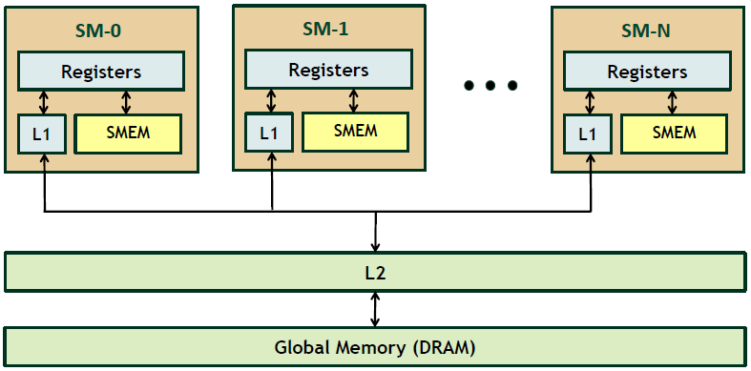
Local memory and caches

Slide 45
Local memory
“Local” because it’s private on a per-thread basis;
it’s actually a global area used to spill out data when SM runs out of resources;
addressing is resolved by the compiler;
cached (store only).

Slide 46
Caches
FERMI architecture introduces caching mechanisms for global memory accesses (constant and texture are cached since 1.0)
L1: private to thread, virtual cache implemented into shared memory
L2: 768KB, grid-coherent, 25% better latency than DRAM
// L1 = 48 KB
// SH = 16 KB
cudaFuncSetCacheConfig( kernel, cudaFuncCachePreferL1 );
// Try to decrease spilled registers eviction from L1,
// disable L1 caching for global memory loads
$ nvcc –Xptas –dlcm=cg
// L1 = 16 KB
// SH = 48 KB
cudaFuncSetCacheConfig( kernel, cudaFuncCachePreferShared );
*Kepler architecture introduced some improvements:
New 32 KB + 32 KB partition option

Slide 47
Execution Optimization

Slide 48
Occupancy
The board’s occupancy is the ratio of active warps to the maximum number of warps supported on a multiprocessor.
Keeping the hardware busy helps the warp scheduler to hide latencies.

Slide 49
Occupancy: constraints
Every board’s resource can become an occupancy limiting factor:
shared memory;
grid and block sizes;
(max threads per SM/max blocks per SM)
used (and spilled) registers
Given an actual kernel configuration, is possible to predict the maximum theoretical occupancy allowed.

Slide 50
Occupancy: block sizing tips
Some experimentation is required.
However there are some heuristic rules:
threads per block should be a multiple of warp size;
a minimum of 64 threads per block should be used;
128-256 threads per block is universally known to be a good starting point for further experimentation;
prefer to split very large blocks into smaller blocks.

Slide 51
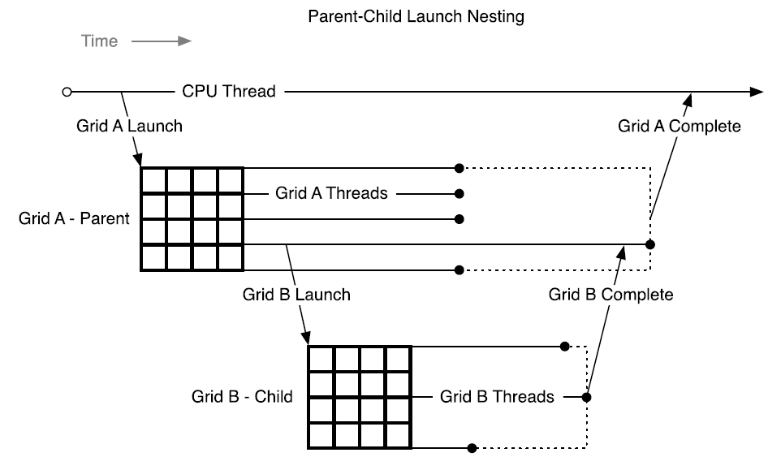
Kepler: dynamic parallelism
One of the biggest CUDA limitations is the need to fit a single grid configuration for the whole kernel.
Kepler (in addition to CUDA 5.x) introduced Dynamic Parallelism
It enables a global kernel to be called from within another kernel
The child grid can be dynamically sized and optionally synchronized
If you need to reshape the grid, you have to resync back to host and split your code.
__global__ ChildKernel(void* data){
//Operate on data
}
__global__ ParentKernel(void *data){
ChildKernel<<<16, 1>>>(data);
}
// In Host Code:
ParentKernel<<<256, 64>>(data);

Slide 52
Instructions
Arithmetic ops:
prefer integer shift operators instead of division and modulo (would be less useful with LLVM);
beware of (implicit) casts (very expensive);
use intrinsics for trascendental functions where possible;
try the fast math implementation.

Slide 53
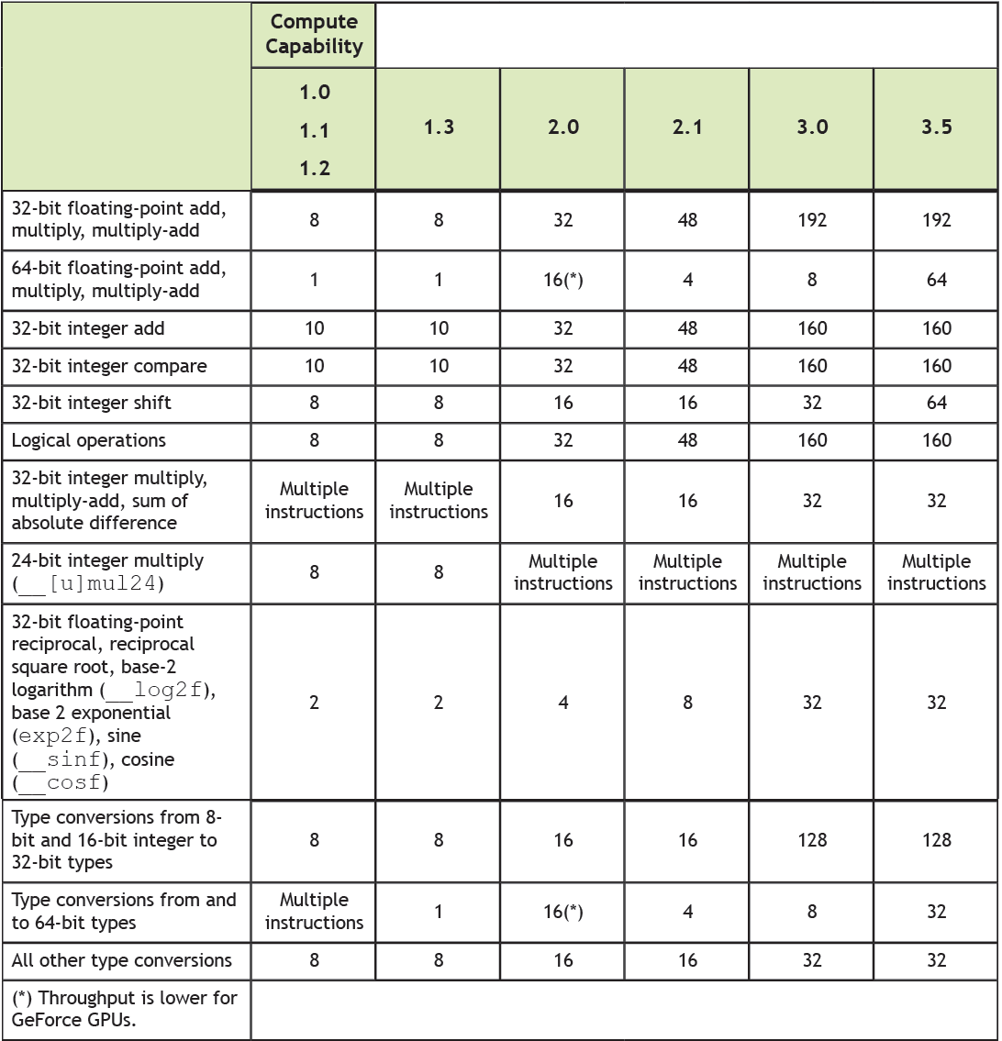
Capability: instruction throughput
instructions x cycle x sm

Slide 54
Control Flow
Different execution paths inside the same warp are managed by the predication mechanism and lead to thread divergence.
if ( threadIdx.x == 0 ) {…}
if ( threadIdx.x == 0 ) {…}
else {…}
if ( threadIdx.x == 0 ) {…}
else if (threadIdx.x == 1) {…}
if ( vec[ threadIdx.x ] > 1.0f ) {…}
Minimize the number of execution branches inside the same warp;
make the compiler’s life easier by unrolling loops (hand-coded, pragma or option);
use signed counters for loops (would be less useful with LLVM);

Slide 55
Exploiting Multi-GPUs
CUDA >= 4.0 introduced the N-to-N bound feature:
Every thread can be bound to any board
Every board can be bound to an arbitrary number of threads
#pragma omp parallel
#pragma omp sections
{
#pragma omp section
{
cutilSafeCall(cudaSetDevice(0));
cudaMemcpy(device_data_1, host_data_1, size, cudaMemcpyHostToDevice);
my_kernel<<< grid, block >>>(device_data_1);
// ...
}
#pragma omp section
{
cutilSafeCall(cudaSetDevice(1));
cudaMemcpy(device_data_2, host_data_2, size, cudaMemcpyHostToDevice);
my_kernel<<< grid, block >>>(device_data_2);
// ...
}
}
Multi-GPU can be exploited through your favourite multi-threading paradigm (OpenMP, pthreads, etc…)

Slide 56
Tools Overview

Slide 57
Development tools
Common
Memory Checker
Built-in profiler
Visual Profiler
Linux
CUDA GDB
Parallel Nsight for Eclipse
Windows
Parallel Nsight for VisualStudio

Slide 58
Profiling tools: built-in
The CUDA runtime provides a useful profiling facility without the need of external tools.
export CUDA_PROFILE=1
export CUDA_PROFILE_CONFIG=$HOME/.config
gld_incoherent: Number of non-coalesced global memory loads
gld_coherent: Number of coalesced global memory loads
gst_incoherent: Number of non-coalesced global memory stores
gst_coherent: Number of coalesced global memory stores
local_load: Number of local memory loads
local_store: Number of local memory stores
branch: Number of branch events taken by threads
divergent_branch: Number of divergent branches within a warp
instructions: instruction count
warp_serialize: Number of threads in a warp that serialize based on address conflicts to shared or constant memory
cta_launched: executed thread blocks
// Contents of config
gld_coherent
gld_incoherent
gst_coherent
gst_incoherent
method,gputime,cputime,occupancy,gld_incoherent,gld_coherent,gst_incoherent,gst_coherent
method=[ memcopy ] gputime=[ 438.432 ]
method=[ _Z17reverseArrayBlockPiS_ ] gputime=[ 267.520 ] cputime=[ 297.000 ] occupancy=[ 1.000 ] gld_incoherent=[ 0 ] gld_coherent=[ 1952 ] gst_incoherent=[ 62464 ] gst_coherent=[ 0 ]
method=[ memcopy ] gputime=[ 349.344 ]

Slide 59
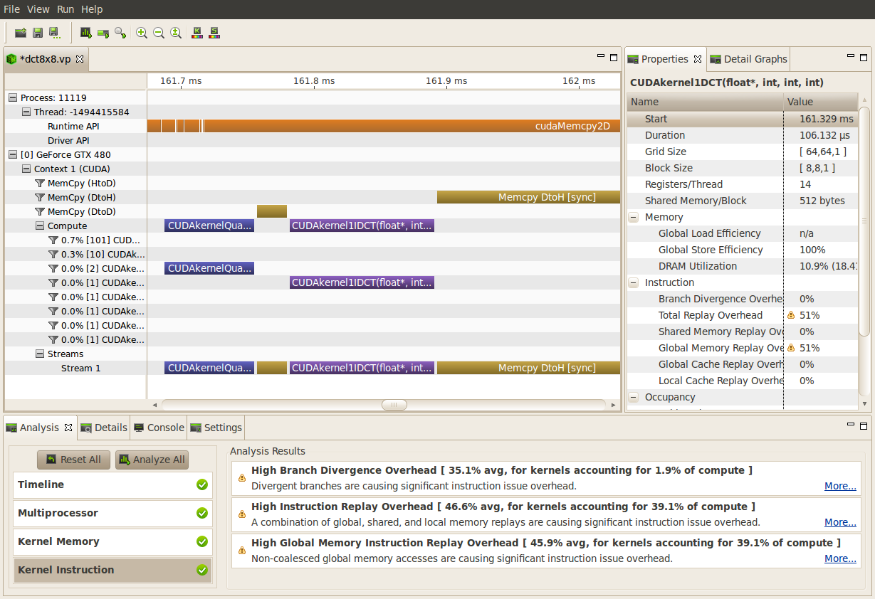
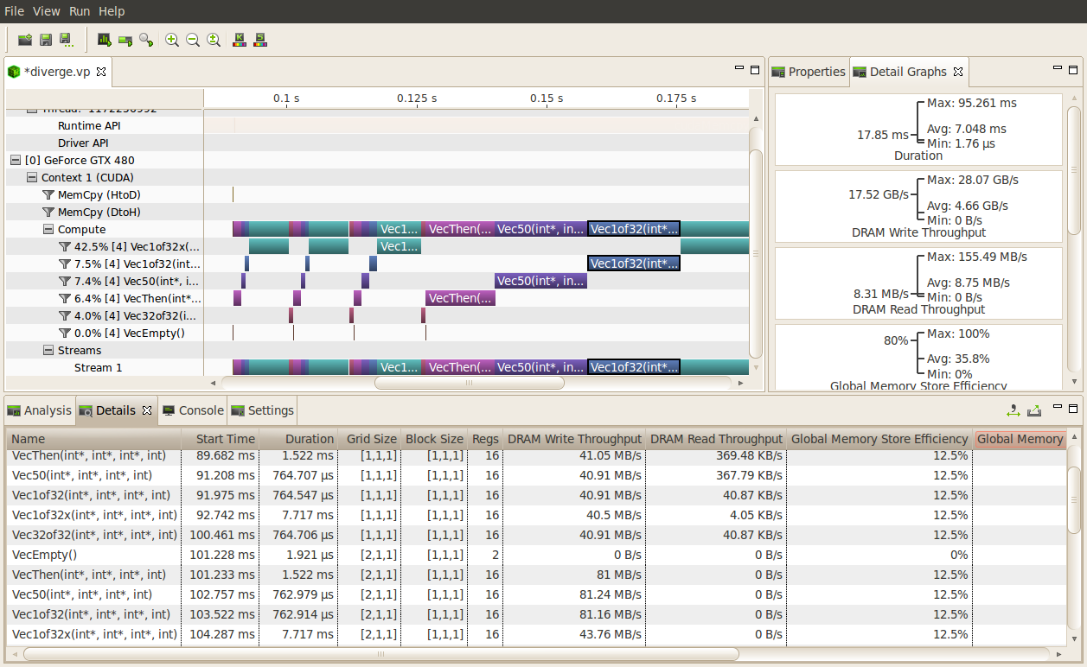
Profiling: Visual Profiler
Traces execution at host, driver and kernel levels (unified timeline)
Supports automated analysis (hardware counters)

Slide 60
Debugging: CUDA-GDB
Well-known tool enhanced with CUDA extensions
Works well on single-gpu systems (OS graphics disabled)
Can be run under GDB-targeted tools and GUIs (multi-gpu systems)
(cuda-gdb) info cuda threads
BlockIdx ThreadIdx To BlockIdx ThreadIdx Count Virtual PC Filename Line
Kernel 0* (0,0,0) (0,0,0) (0,0,0) (255,0,0) 256 0x0000000000866400 bitreverse.cu 9
(cuda-gdb) thread
[Current thread is 1 (process 16738)]
(cuda-gdb) thread 1
[Switching to thread 1 (process 16738)]
#0 0x000019d5 in main () at bitreverse.cu:34
34 bitreverse<<<1, N, N*sizeof(int)>>>(d);
(cuda-gdb) backtrace
#0 0x000019d5 in main () at bitreverse.cu:34
(cuda-gdb) info cuda kernels
Kernel Dev Grid SMs Mask GridDim BlockDim Name Args
0 0 1 0x00000001 (1,1,1) (256,1,1) bitreverse data=0x110000

Slide 61
Debugging: CUDA-MEMCHECK
It’s able to detect buffer overflows, misaligned global memory accesses and leaks
Device-side allocations are supported
Standalone or fully integrated in CUDA-GDB
$ cuda-memcheck --continue ./memcheck_demo
========= CUDA-MEMCHECK
Mallocing memory
Running unaligned_kernel
Ran unaligned_kernel: no error
Sync: no error
Running out_of_bounds_kernel
Ran out_of_bounds_kernel: no error
Sync: no error
========= Invalid __global__ write of size 4
========= at 0x00000038 in memcheck_demo.cu:5:unaligned_kernel
========= by thread (0,0,0) in block (0,0,0)
========= Address 0x200200001 is misaligned
=========
========= Invalid __global__ write of size 4
========= at 0x00000030 in memcheck_demo.cu:10:out_of_bounds_kernel
========= by thread (0,0,0) in block (0,0,0)
========= Address 0x87654320 is out of bounds
=========
=========
========= ERROR SUMMARY: 2 errors

Slide 62
Parallel NSight
Plug-in for major IDEs (Eclipse and VisualStudio)
Aggregates all external functionalities:
Debugger (fully integrated)
Visual Profiler
Memory correctness checker
As a plug-in, it extends all the convenience of IDEs to CUDA
On Windows systems:
Now works on a single GPU
Supports remote debugging and profiling
Latest version (2.2) introduced live PTX assembly view, warp inspector and expression lamination

Slide 63
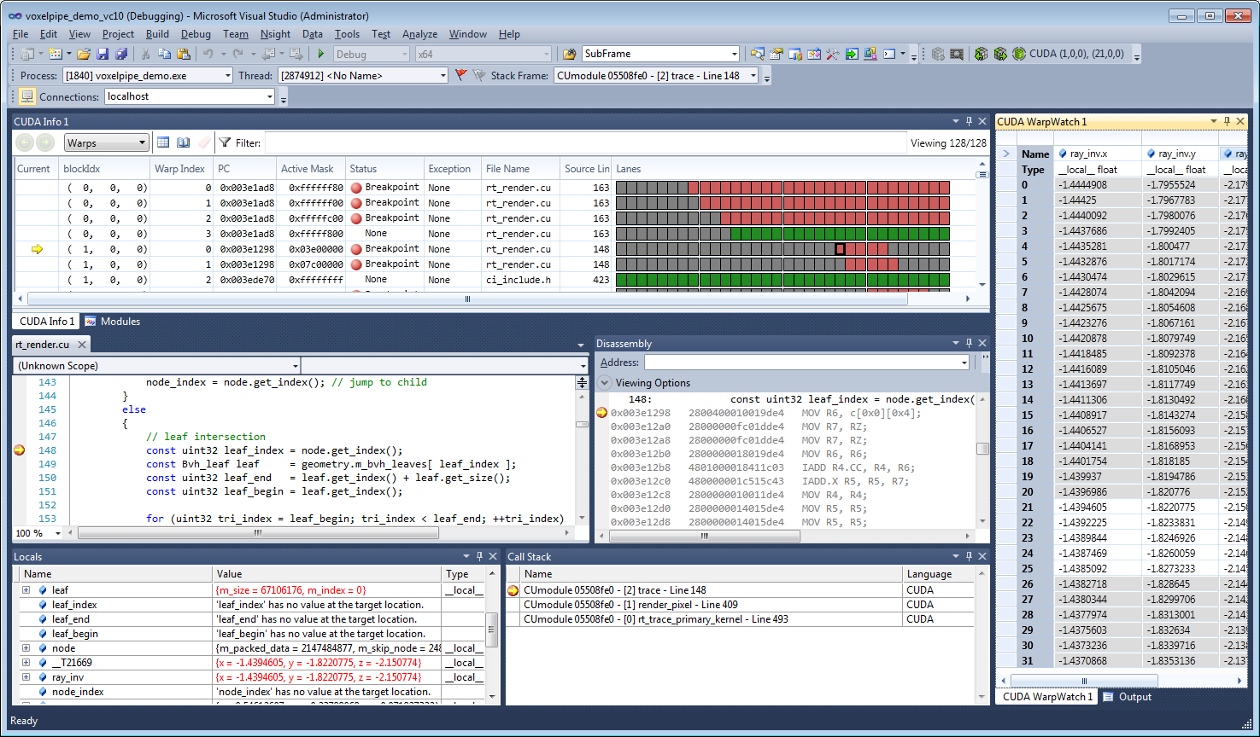
Parallel NSight

Slide 64
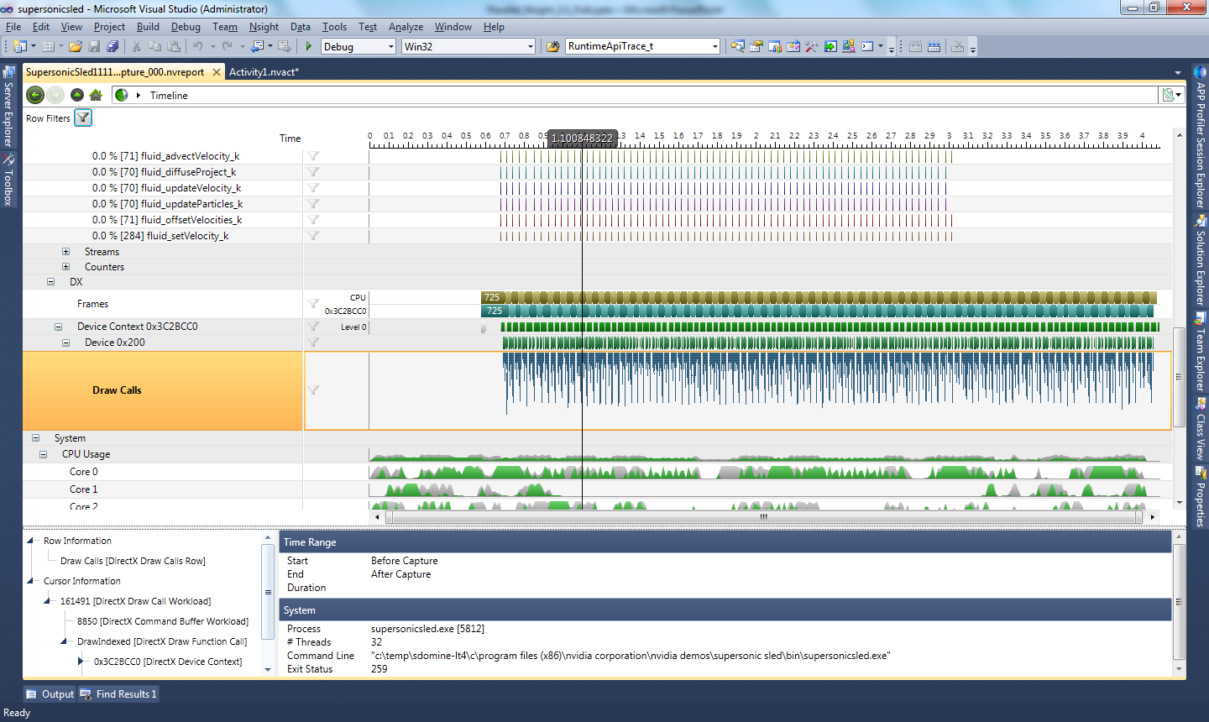
Parallel NSight

